Slide 1
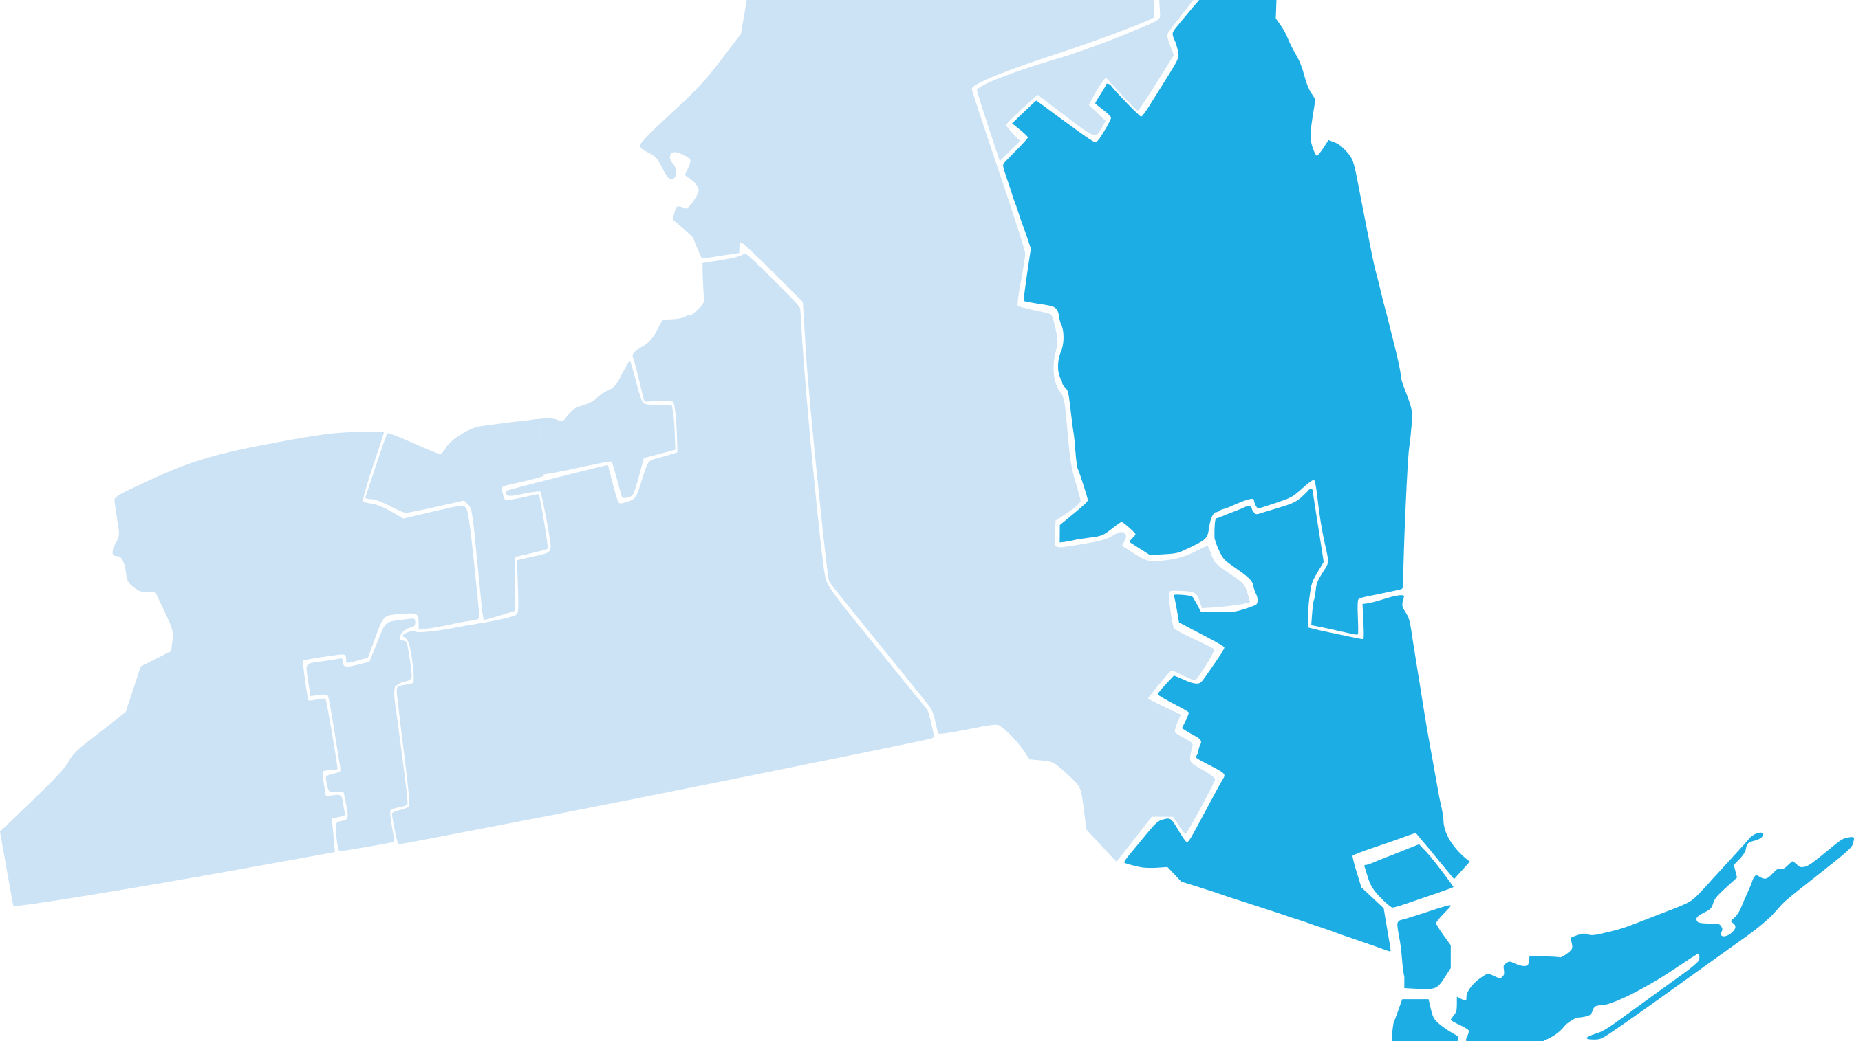
Decarbonizing New York’s Power Sector
Cooper Union Masters Thesis Defense (9/14/2020)
Author: Zach Tzavelis
Advisors: Professor Sidebotham (Cooper Union)
Josh Novacheck (National Renewable Energy Laboratory)

Slide 2

Agenda
Introduction to NY’s Power Sector (5 mins)
Problem Definition, Framework, Literature (5 mins)
Insights (20 mins)
Methodology (5 mins)
Conclusion (5 mins)
Q/A (10 mins)
Notes:
Before we get started, I would like to run through a quick overview of what we are going to cover today.
We’ll start with an introduction to what the power sector and decarbonization is – so that were are all on the same page about what we are talking about – I understand that this subject may be new to many of you.
We’ll then talk about the problem we are trying to solve, the framework I used to analyze the problem, and how my work fits in with the existing literature out there.
Next well talk about the insights that I gained from my study particularly on how NY can decarbonize its power sector. I’ll spend the majority of the presentation talking about these takeaways.
Then well take a step back and discuss my modeling methodology, essentially looking at how I arrived at my insights.
Ill wrap up the presentation with a summary of my conclusions and before we jump into my what I am most looking forward to- your questions.
With that roadmap outlined, lets jump right into the basics of ny’s power system and the challenge it faces…

Slide 3
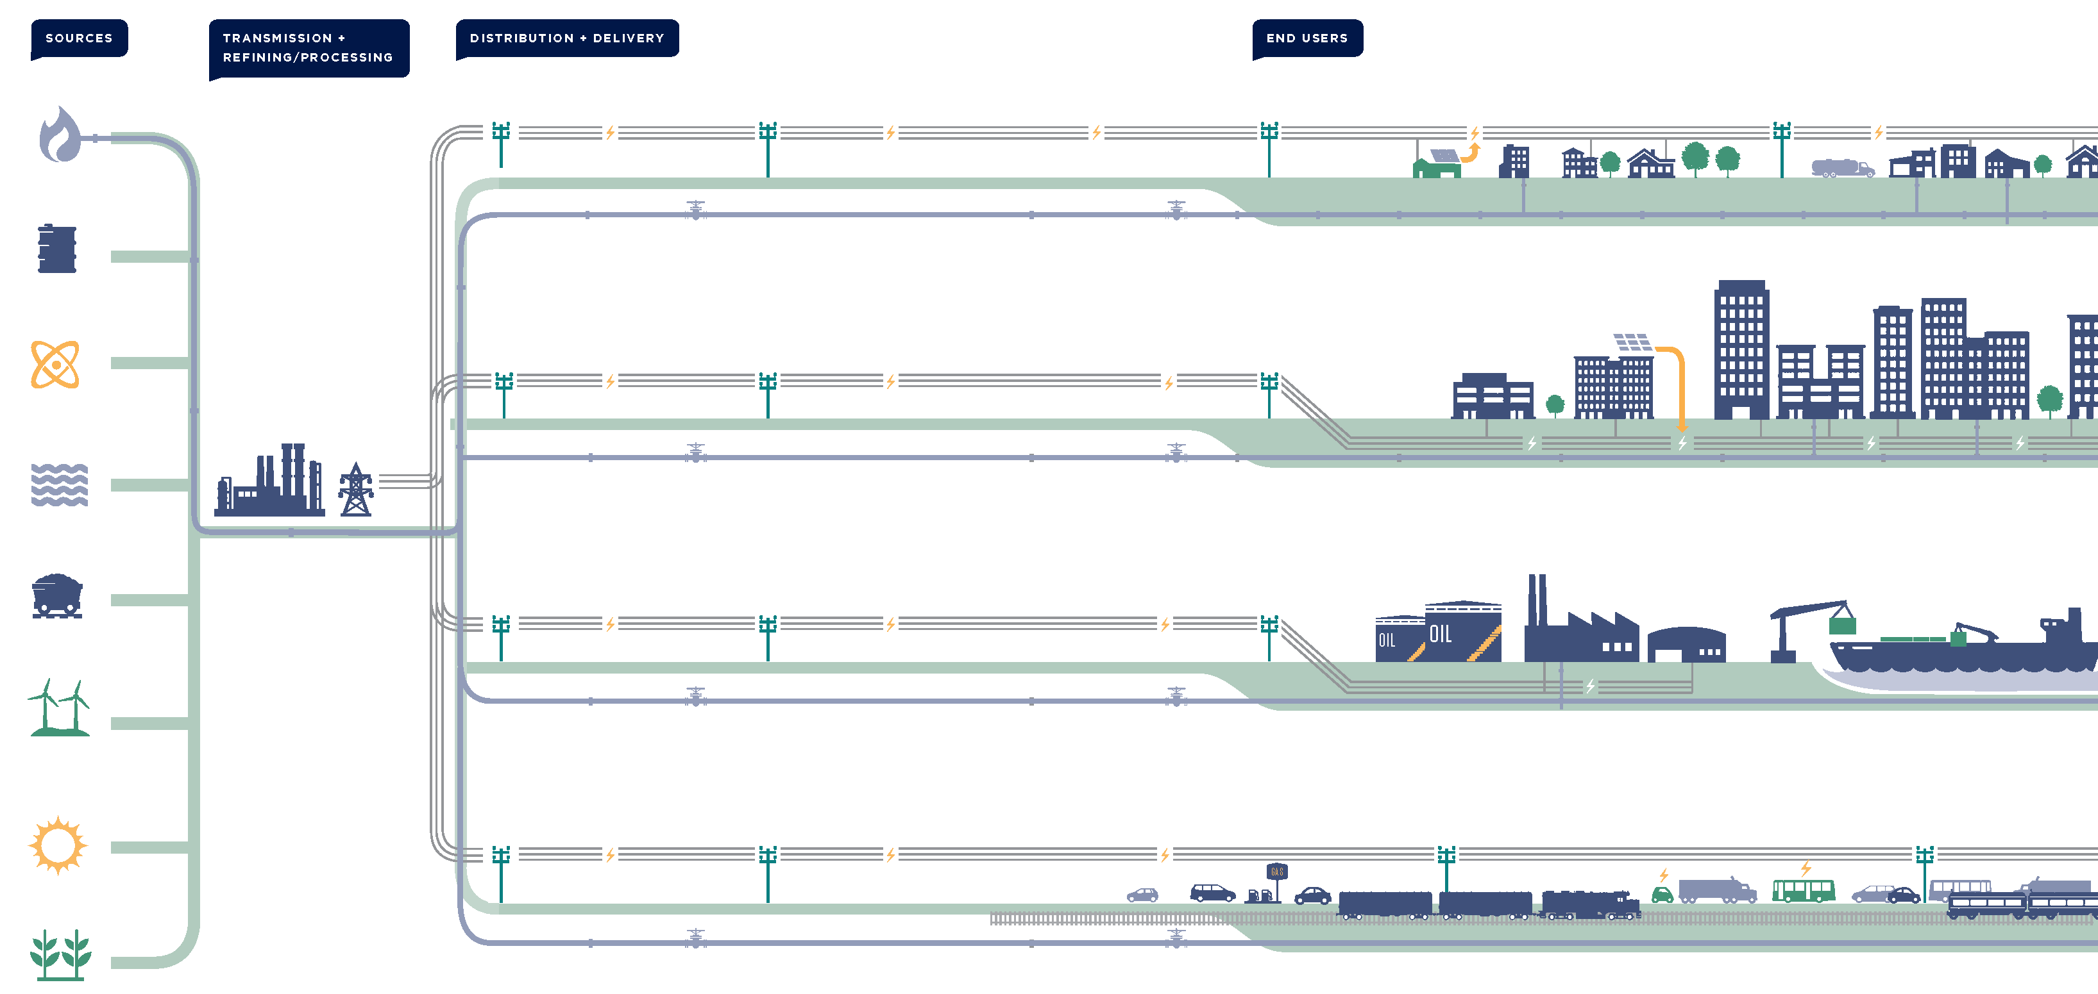
Power Sector? Decarbonization?
Source: energyplan.ny.gov
Notes:
The title of my thesis is decarbonizating NY’s power sector. And the power sector refers essentially to the electric grid and the generators that are used to produce electricity to power our every day lives.
In this graphic you can see an overview of the power sector supply chain. our energy sources on the left: you can see fuel-based energy sources that require combustion, you can see wind and solar resources, as well energy sources like nuclear power.
Decarbonization means reducing or even eliminating carbon dioxide from something.Decarbonizing the power sector mostly refers to reducing and eliminating the carbon dioxide produced from the combustion process.
The transmission system are the high voltage cables that transport the electricity over long distances to local distribution networks that then distribute the electricity to end users like homes, businesses, and other industries.

Slide 4



New York’s Status
Power Sector Emissions in Context
2005 GHG Emissions* | 53.58
2016 GHG Emissions* | 27.72
% of NY Total GHG | 13%
% of USA Total GHG | 0.48%
% of Global Total GHG | 0.06%
* Units: [MMt CO2e/yr] Source: 2016 NY Greenhouse Gas Inventory & Our World In Data
Grid Stakeholders
Government: Office of the Governor/NYPSC
Public Benefit Organizations: NYSERDA/NYISO
Utilities: ConEdison, National Grid
Research
Policy
Implement
Solutions
Notes:
So why do we need to decarbonize our power infrastructure? Well, because of climate change and in particular the power sector needs to be decarbonized because other economic sectors such as the building sector, and increasingly the transportation sector, rely on the electric grid for power. Without decarbonizing our powersector we cannot achieve economy wide decarbonization that is what we must do to tackle climate change.
As seen in the table, NY’s power sector currently accounts for 13% of the total economy wide GHG emissions. This percentage is relatively low compared to other states, due to a combination of the fact that NY is very progressive in tackling the problem, well situated were it has access to carbon-free resources, and is densely populated allowing for increased efficiency in delivering power to these areas.
To tackle this challenge collaboration is needed among grid stakeholders in government, public benefit organizations and utilities on research, crafting policy, and implementation.
Policies by Justin Blake from the Noun Project
3d modeling by Berkah Icon from the Noun Project
implementation by Komkrit Noenpoempisut from the Noun Project
Government create regulations and policies for the electric grid sector (they essentially create the rules)
Office of the Governor help craft policies related to the grid, such as the climate leadership and community protection act (CLCPA)
New York Public Service Commission is the public utilities commission of the New York state government that regulates and oversees the electric, gas, water, and telecommunication industries in New York as part of the Department of Public Service.
Public Benefit Organizations

Slide 5
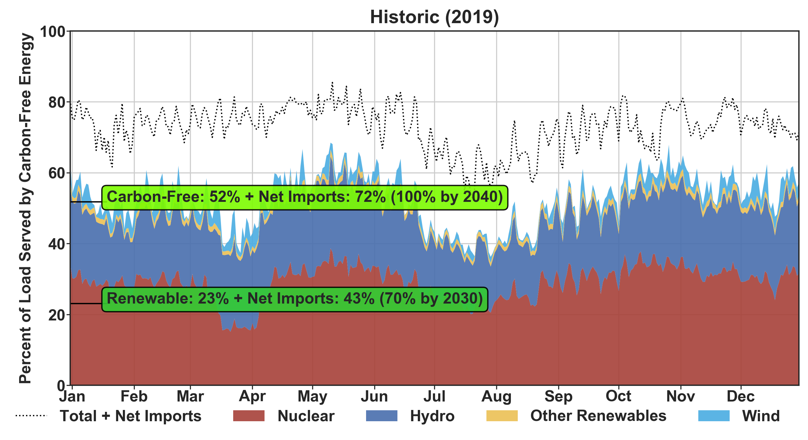




Where is NY now?
Climate Leadership and Community Protection Act (CLCPA) Goals
Carbon-free Energy (100% by 2040)
Renewable Energy (70% by 2030)
Hydro
Wind
Solar
Nuclear
GitHub: NYISOToolkit
Notes:
So here you see a diagram that shows the goals of the Climate Leadership and Community Protection Act (CLCPA) – that was signed into law July of 2019.
The goals apply to renewable and carbonfree generation. The first goal says that 100% of the load in 2040 and afterwards must be served by carbon free resources: such as ….
The second goal is for 2030 and says that 70% of the load needs to be served by renewables resources.
Its important for me to stress two points
1. these requirements are specifically aimed at power utilities – that can generate power on their own, buy from other instate generators, or import from out of state to meet these goals.
2. The requirements require that these goals be met by as a percent of LOAD, not as a percent of generation, so you can’t cheat.
So how far along are we to achieving these goals? This graph shows how what percent of the load was served by carbon-free sources for each day of 2019. The colors show what portion of that energy came from each source – such as nuclear, hydro, other renewables, wind. Overlayed on top are two status bars that track the progress towards achieving the two goals of the CLCPA. The top, dark green one shows what percent of the total yearly load was served by carbon free resources, while the bottom shows what percent of the annual load was served by renewable energy. To the right of each it shows what thatnumber would be assuming all the net imports came from those same sources, and all the way on the right is a reminder of what the goals are.
Policies by Justin Blake from the Noun Project
3d modeling by Berkah Icon from the Noun Project

Slide 6



Literature and Problem Definition
Thesis Focus
Analyze the technical feasibility of achieving CLCPA goals:
100% Carbon-free by 2040
70% Renewable by 2030
Relevant Studies
(2040 Model)
McKinsey “The Global Relevance of NY’s
Clean Energy Goals”
(2050 Model)
NREL “Standard Scenarios”
Problem Definition
Minimize the cost of operating and developing power grid while meeting demand, policy, and reliability constraints
Notes:
So the focus of my thesis was to analyze the technical feasibility of achieving the aforementioned goals of the CLCPA.
I completed my work in the context of two relevant pieces of literature…..(these ones) (from here on out they are called 2040 and 2050 Model respectively. I used the installed capacity configurations from these two studies to construct two possible scenarios of the future.
So I basically was looking at could the two system configurations specified in the study achieve the goals? I also created a third model of the 2019 system and compared it to the actual historical operation as a kind of baseline test.
In all of these studies, we are essentially doing technoeconomic simulation of the energy market – and deciding which generators get dispatched based on their cost and availability. Formally the mathematical problem the simulation software is solving for is a mixed integer optimization problem with an objective function which is the production cost. Our objective is to minimize the production cost of electricity to meet the load, and operate the generators within their operating range.
Search by Matteo Costa from the Noun Project
Puzzle by DinosoftLab from the Noun Project

Slide 7
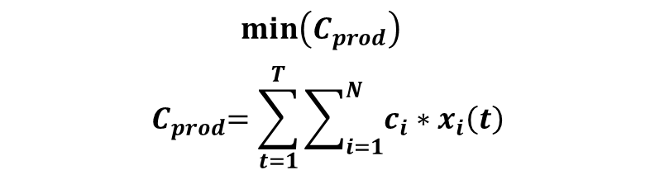
Modeling Details
Capacity Expansion Models (McKinsey & NREL)
Definition: Long term study of power system evolution
Objective: Minimize the cost of installing/retiring generation and transmission
Insight: How will the system evolve over time?
Production Cost Minimization
(Mixed Integer Optimization Problem)
Production Cost Models
$$min\left(C_{prod}\right)$$
$${ C}_{prod}=\sum_{t=1}^{T}{\sum_{i=1}^{N}{c_{i}∗x_{i}\left(t\right)}}$$
Definition: Detailed hourly operational simulation
Objective: Minimize the overall cost of dispatching generators
Insight: Detailed operational differences between years of study
McKinsey
NREL
My Models
2019
2030
2040
2050
Notes:
PC
Detailed hourly operational study (which generators get dispatched?)
How does the ENERGY MIX CHANGE
CE
Long term study of power system evolution (How does the system evolve over time?)

Slide 8
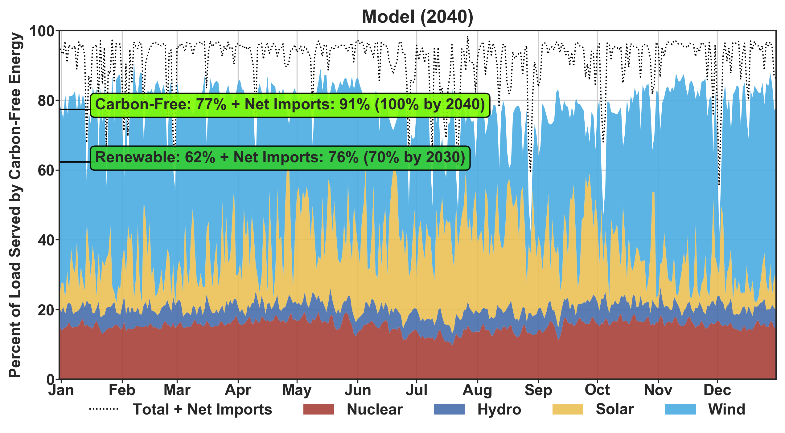
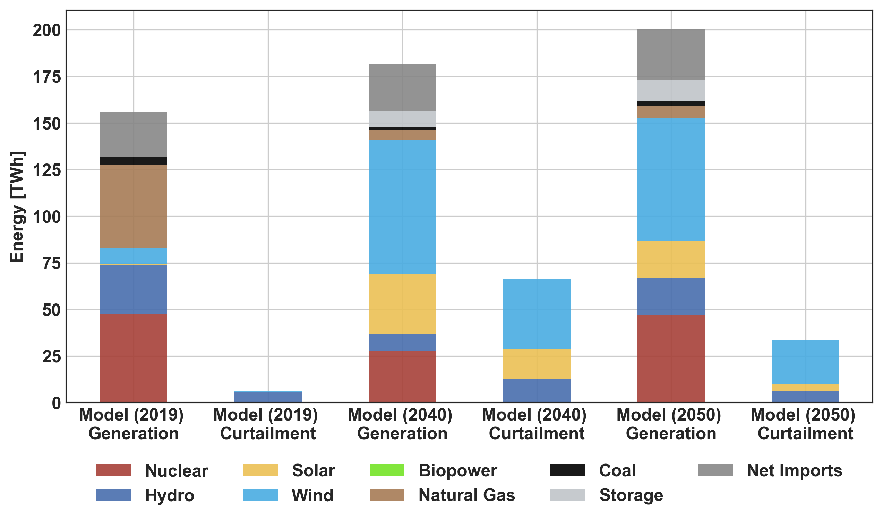
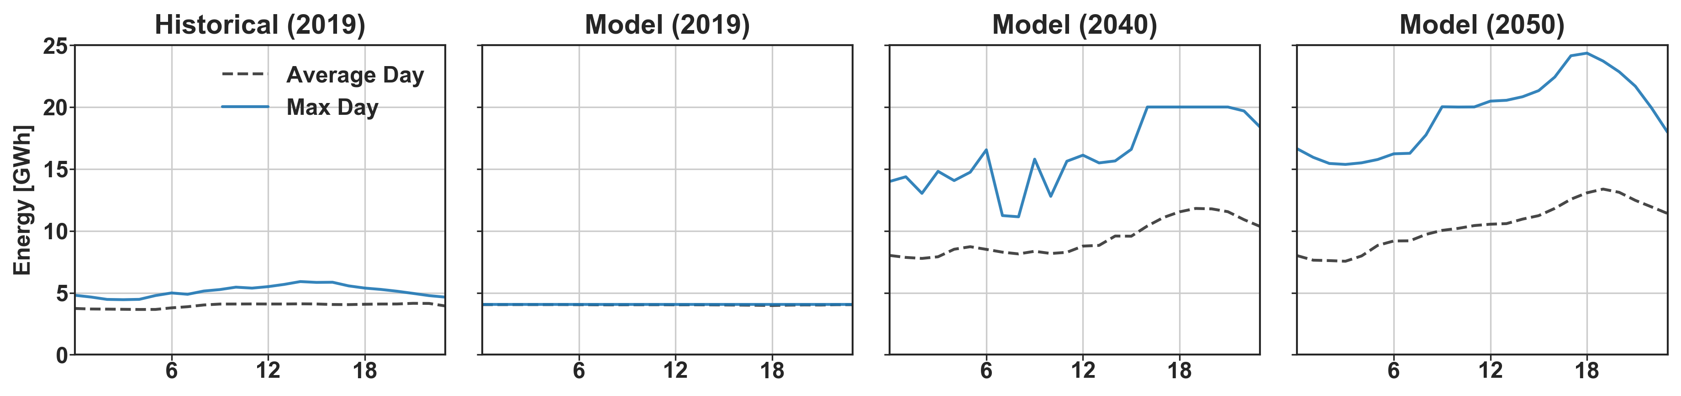
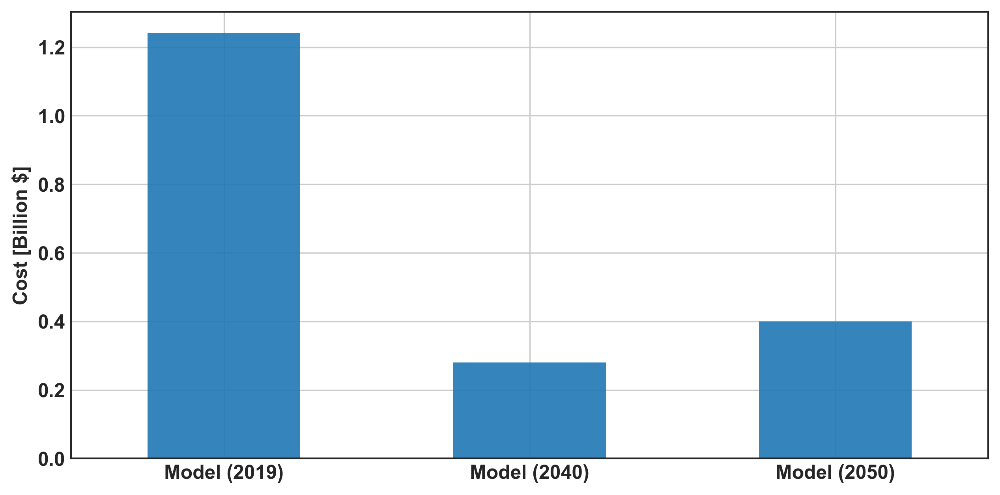
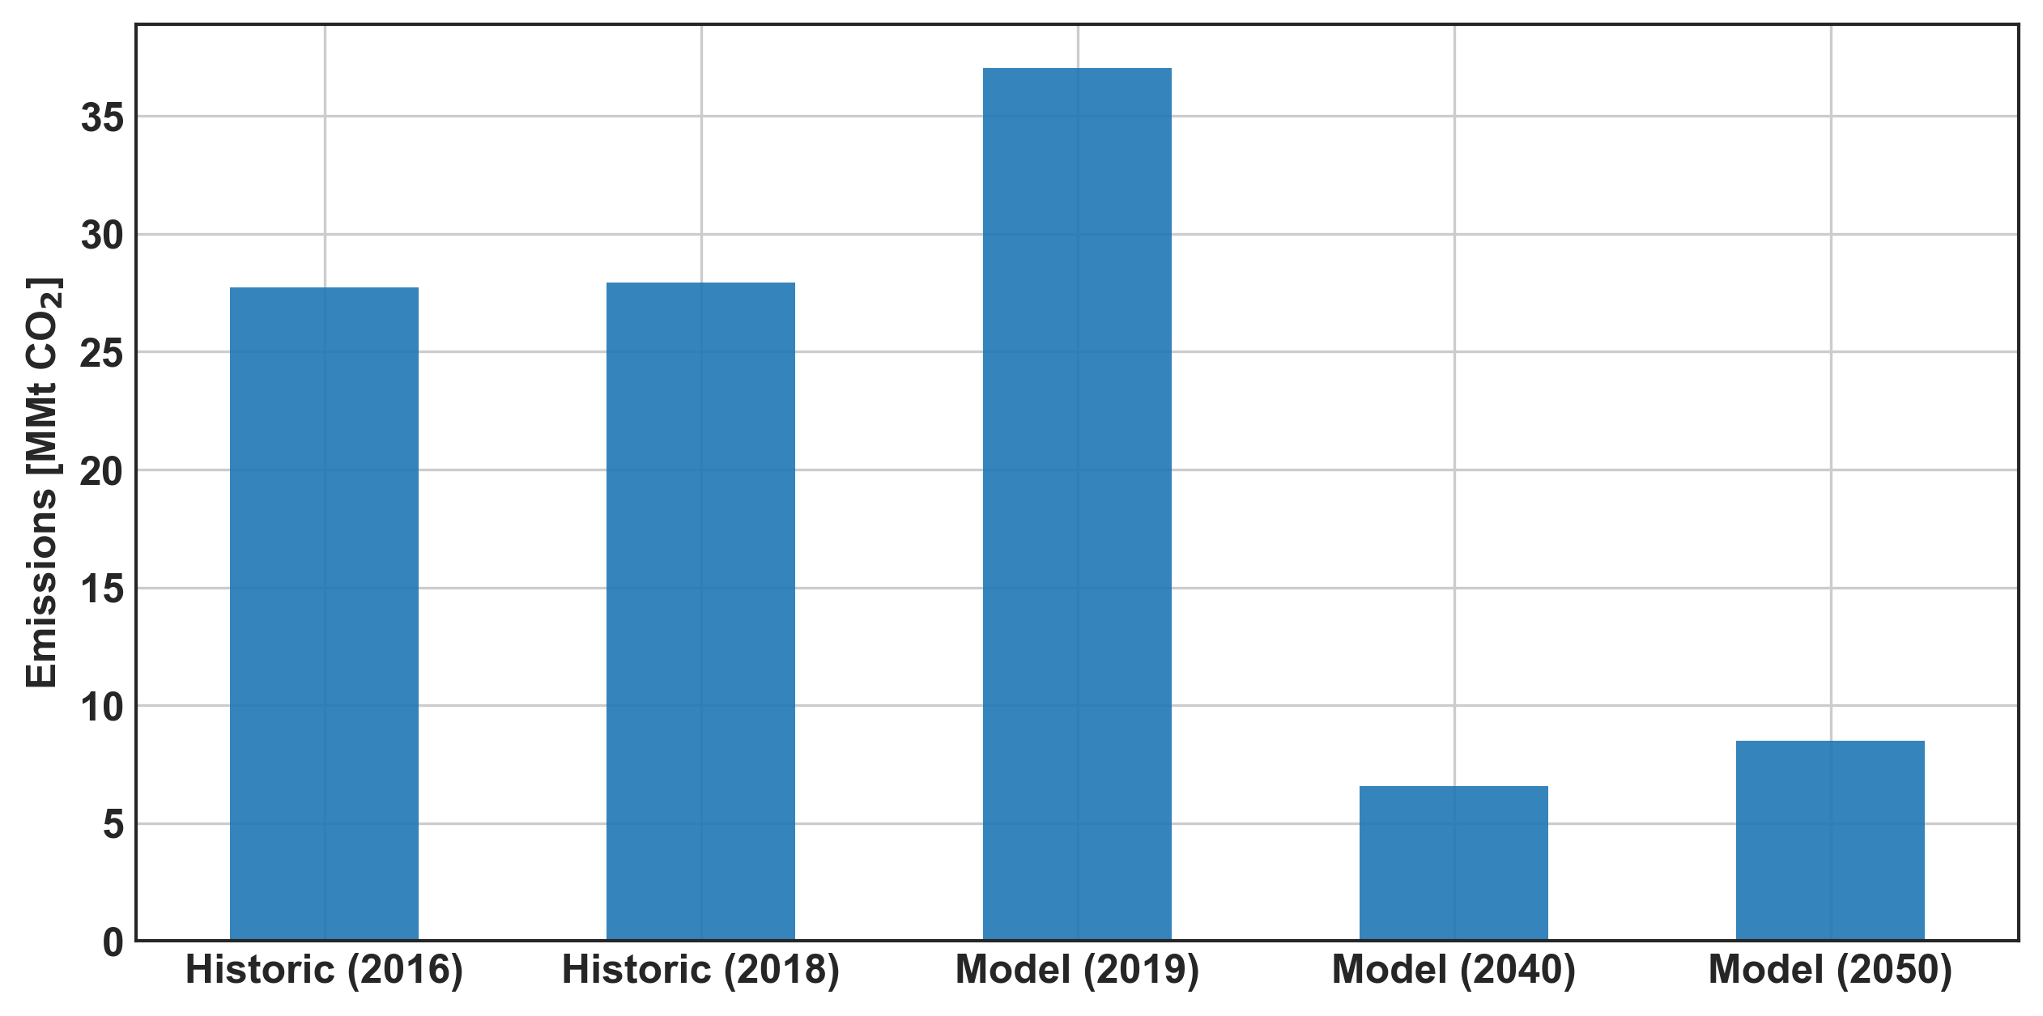
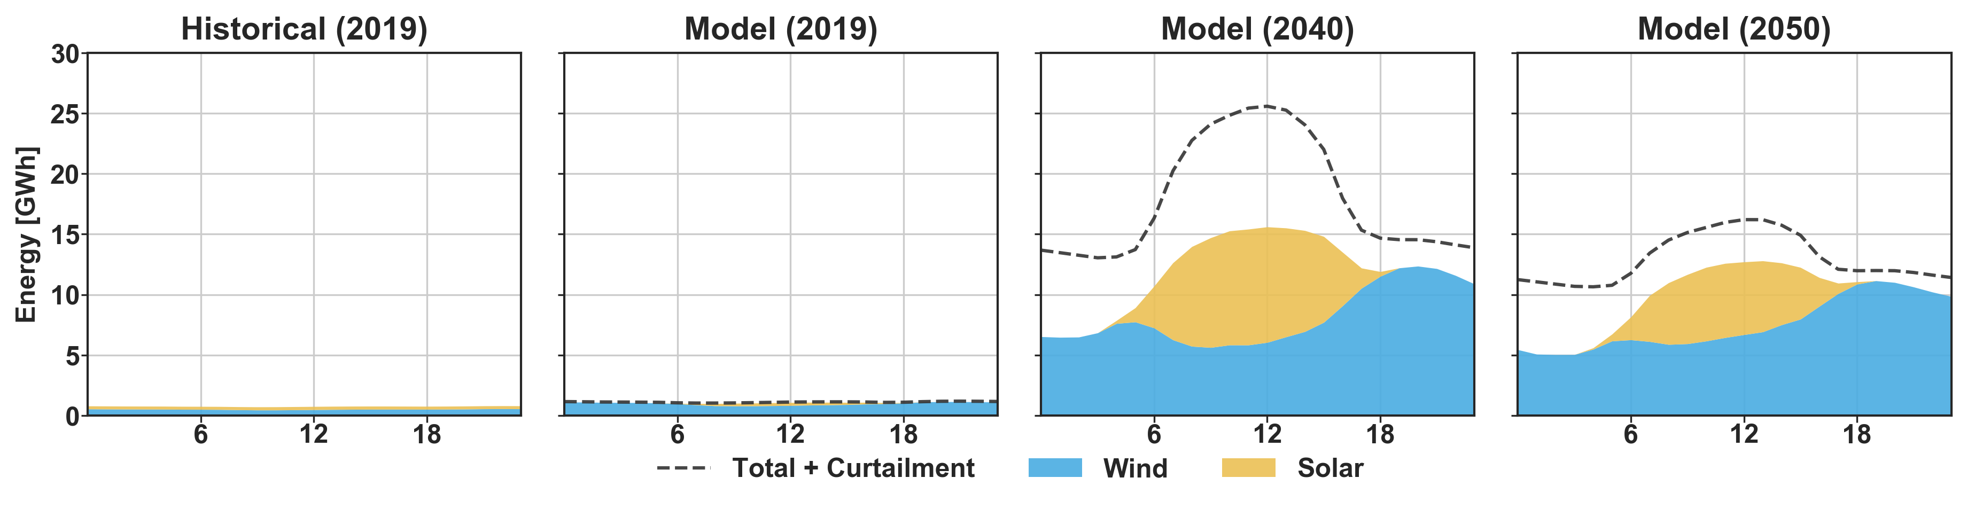
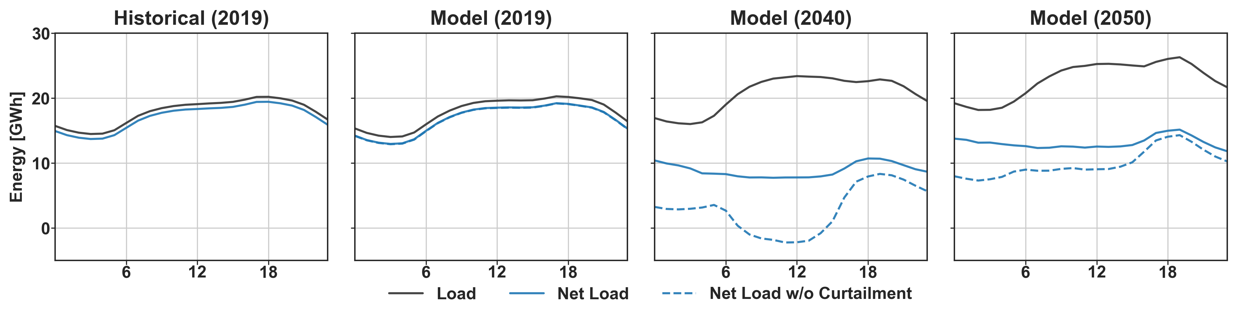
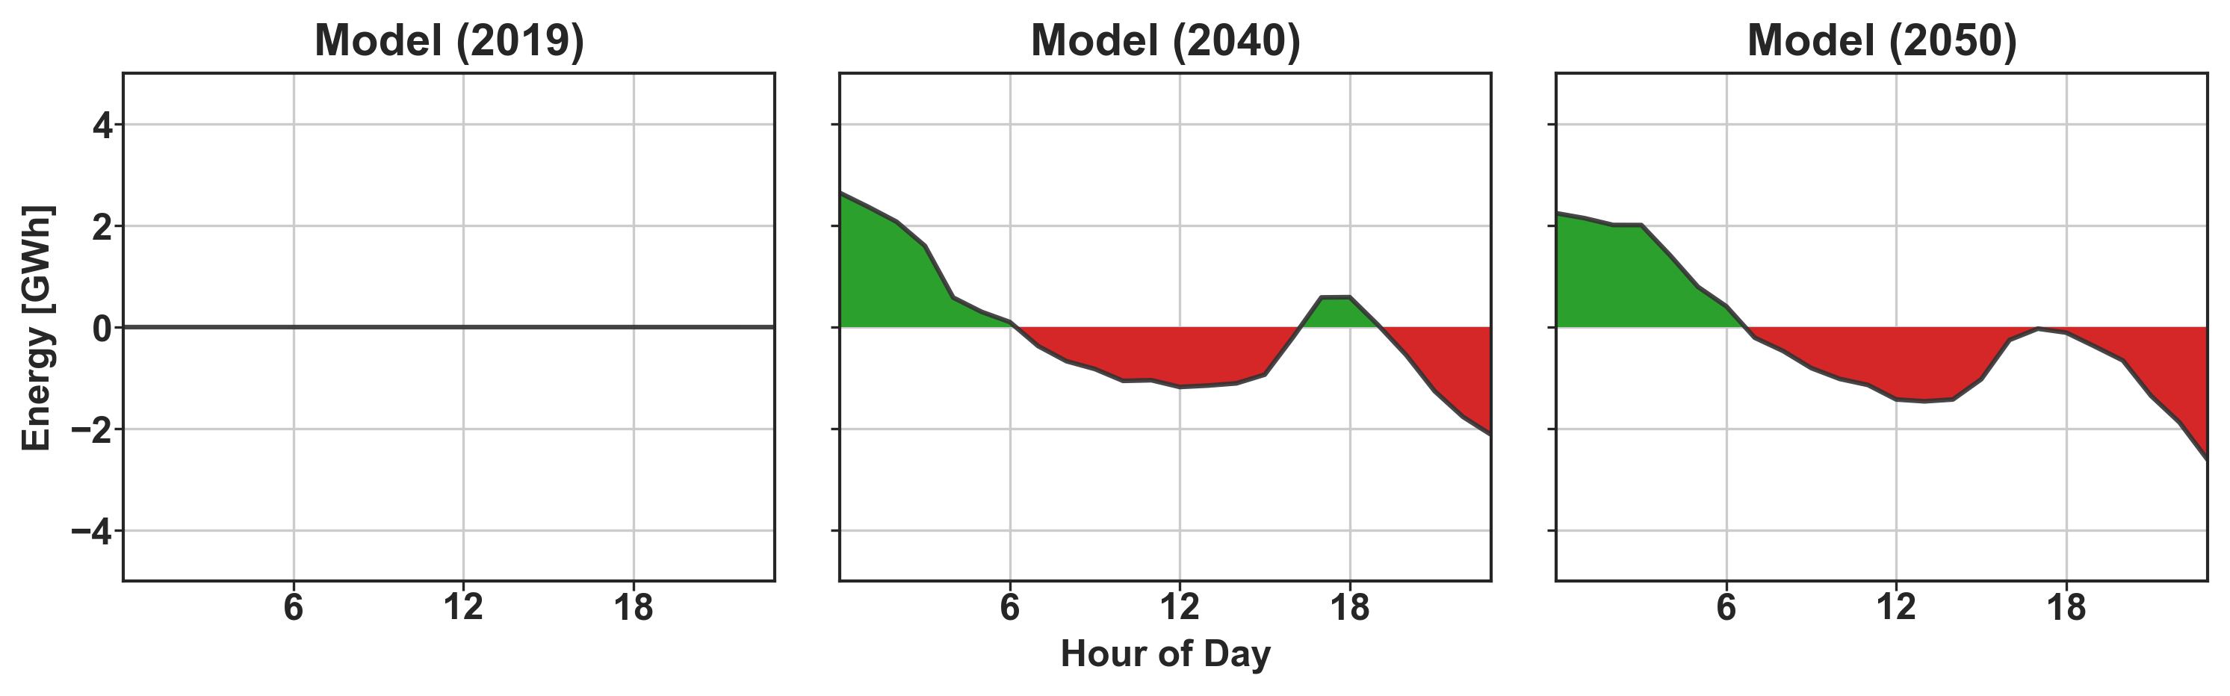
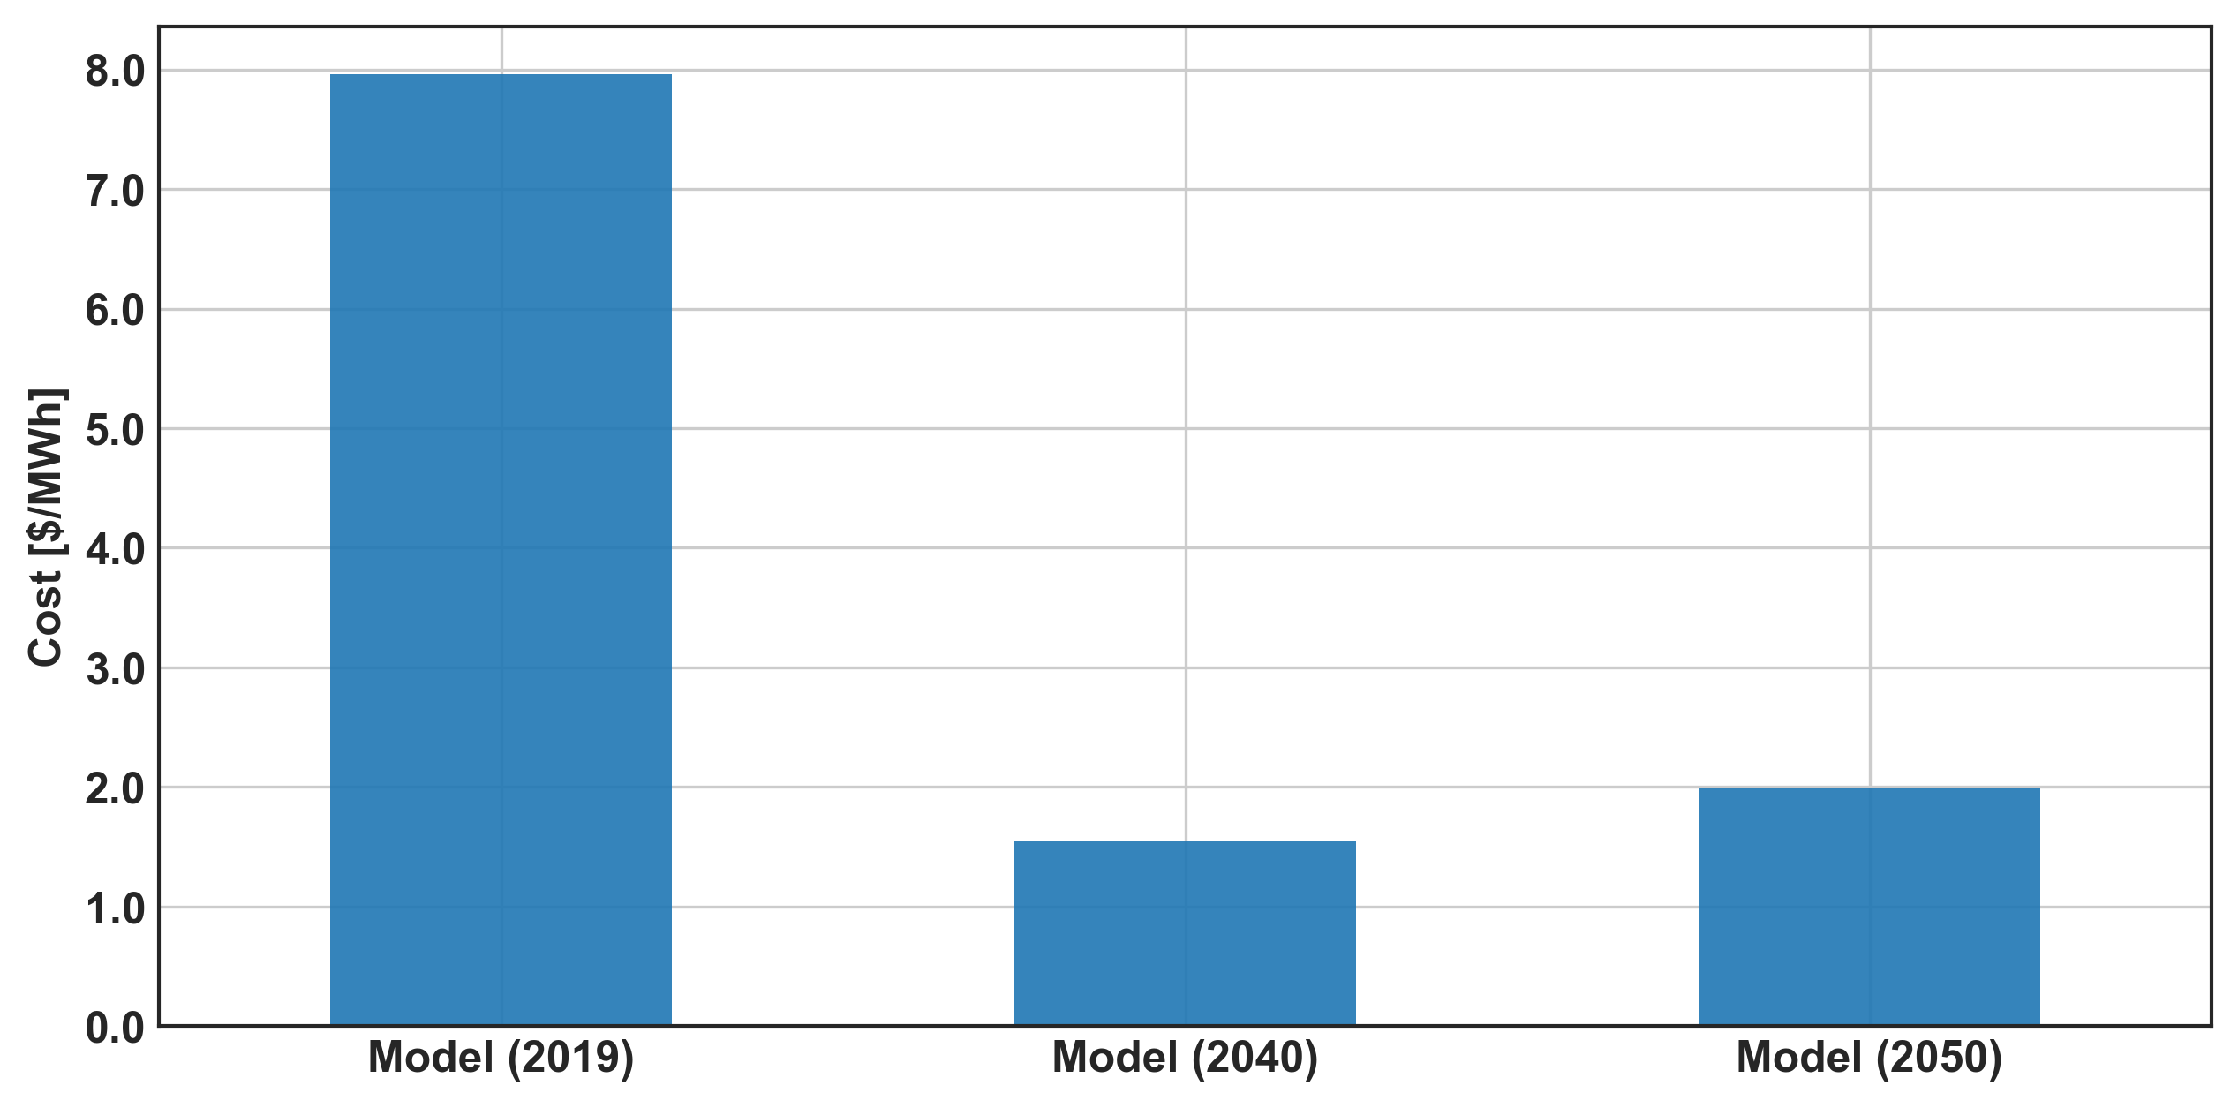
Power System Planning Framework
Environment
Operation
Economics
Supply/Demand
Flexibility
Decarbonization
Energy Mix + Curtailment
Transmission
Total Production Cost
Emissions
Resource and Net Load
Battery Storage
Average Production Cost
Notes:
To analyze the operational changes of the future power system, I came up with a power system planning framework consisting of measures in three major categories: those impacting the environment, operational changes, and economic measures.
- In the Environment category, I looked at the precent of load served by dicarbon free and renewable sources. And emissions.
In the operation cateogiry I looked at several measures for analyzing the supply/demand including, energy mix, curtailment, resource availability, and net load curves. I also looked at sources of flexibility: including requirements for transmission capacity, and the operation of battery storage.
- Lastly I looked at the economics of each model, including the annual cost and the electricity price.

Slide 9
Decarbonization Insights
NY could evolve from 52% carbon-free to 77% carbon-free (91% including imports)
Decarbonization is driven by wind and solar (Renewables 23% -> 62%)
Still fall short of carbon-free CLCPA goal
Notes:
- My modeling results show that NY could go from a system which is about 50% carbon free to one that is about 75% carbon free. As seen in the two graphs below we have the mckinsey model for 2040 on the left and the nrel 2050 model on the right. Th annual percent carbon free is just above 75% not including imports, and about 91% including imports. As a reminder the goal is 100%, so under the 2013 weather year my models indicate that they wouldn’t achieve the goals.
- Nonetheless there is significant improvement in the carbon free operation of the system- which is driven primarily by wind and solar resource – which goes from 23% in 2019 to 50-60% in these models.

Slide 10
Emission Insights
New York’s power system could produce about 18% of the current instate-emissions
Notes:
We talked about decarbonization status, but what does that mean in terms of emissions – which is ultimately what we care about when talking about climate change.
The left 2 bars in this graph show historical emissions from 2016 and 2018, while the right show the model emissions.
-The actual 2019 emission data has not been released yet, but the actual magnitude of emissions by the 2019 is likely too high – but the same is true for 2040 and 2050.
- So if we just focus on the relative difference, the models indicate that we could achieve a power system with about 20% of the current instate emissions.

Slide 11
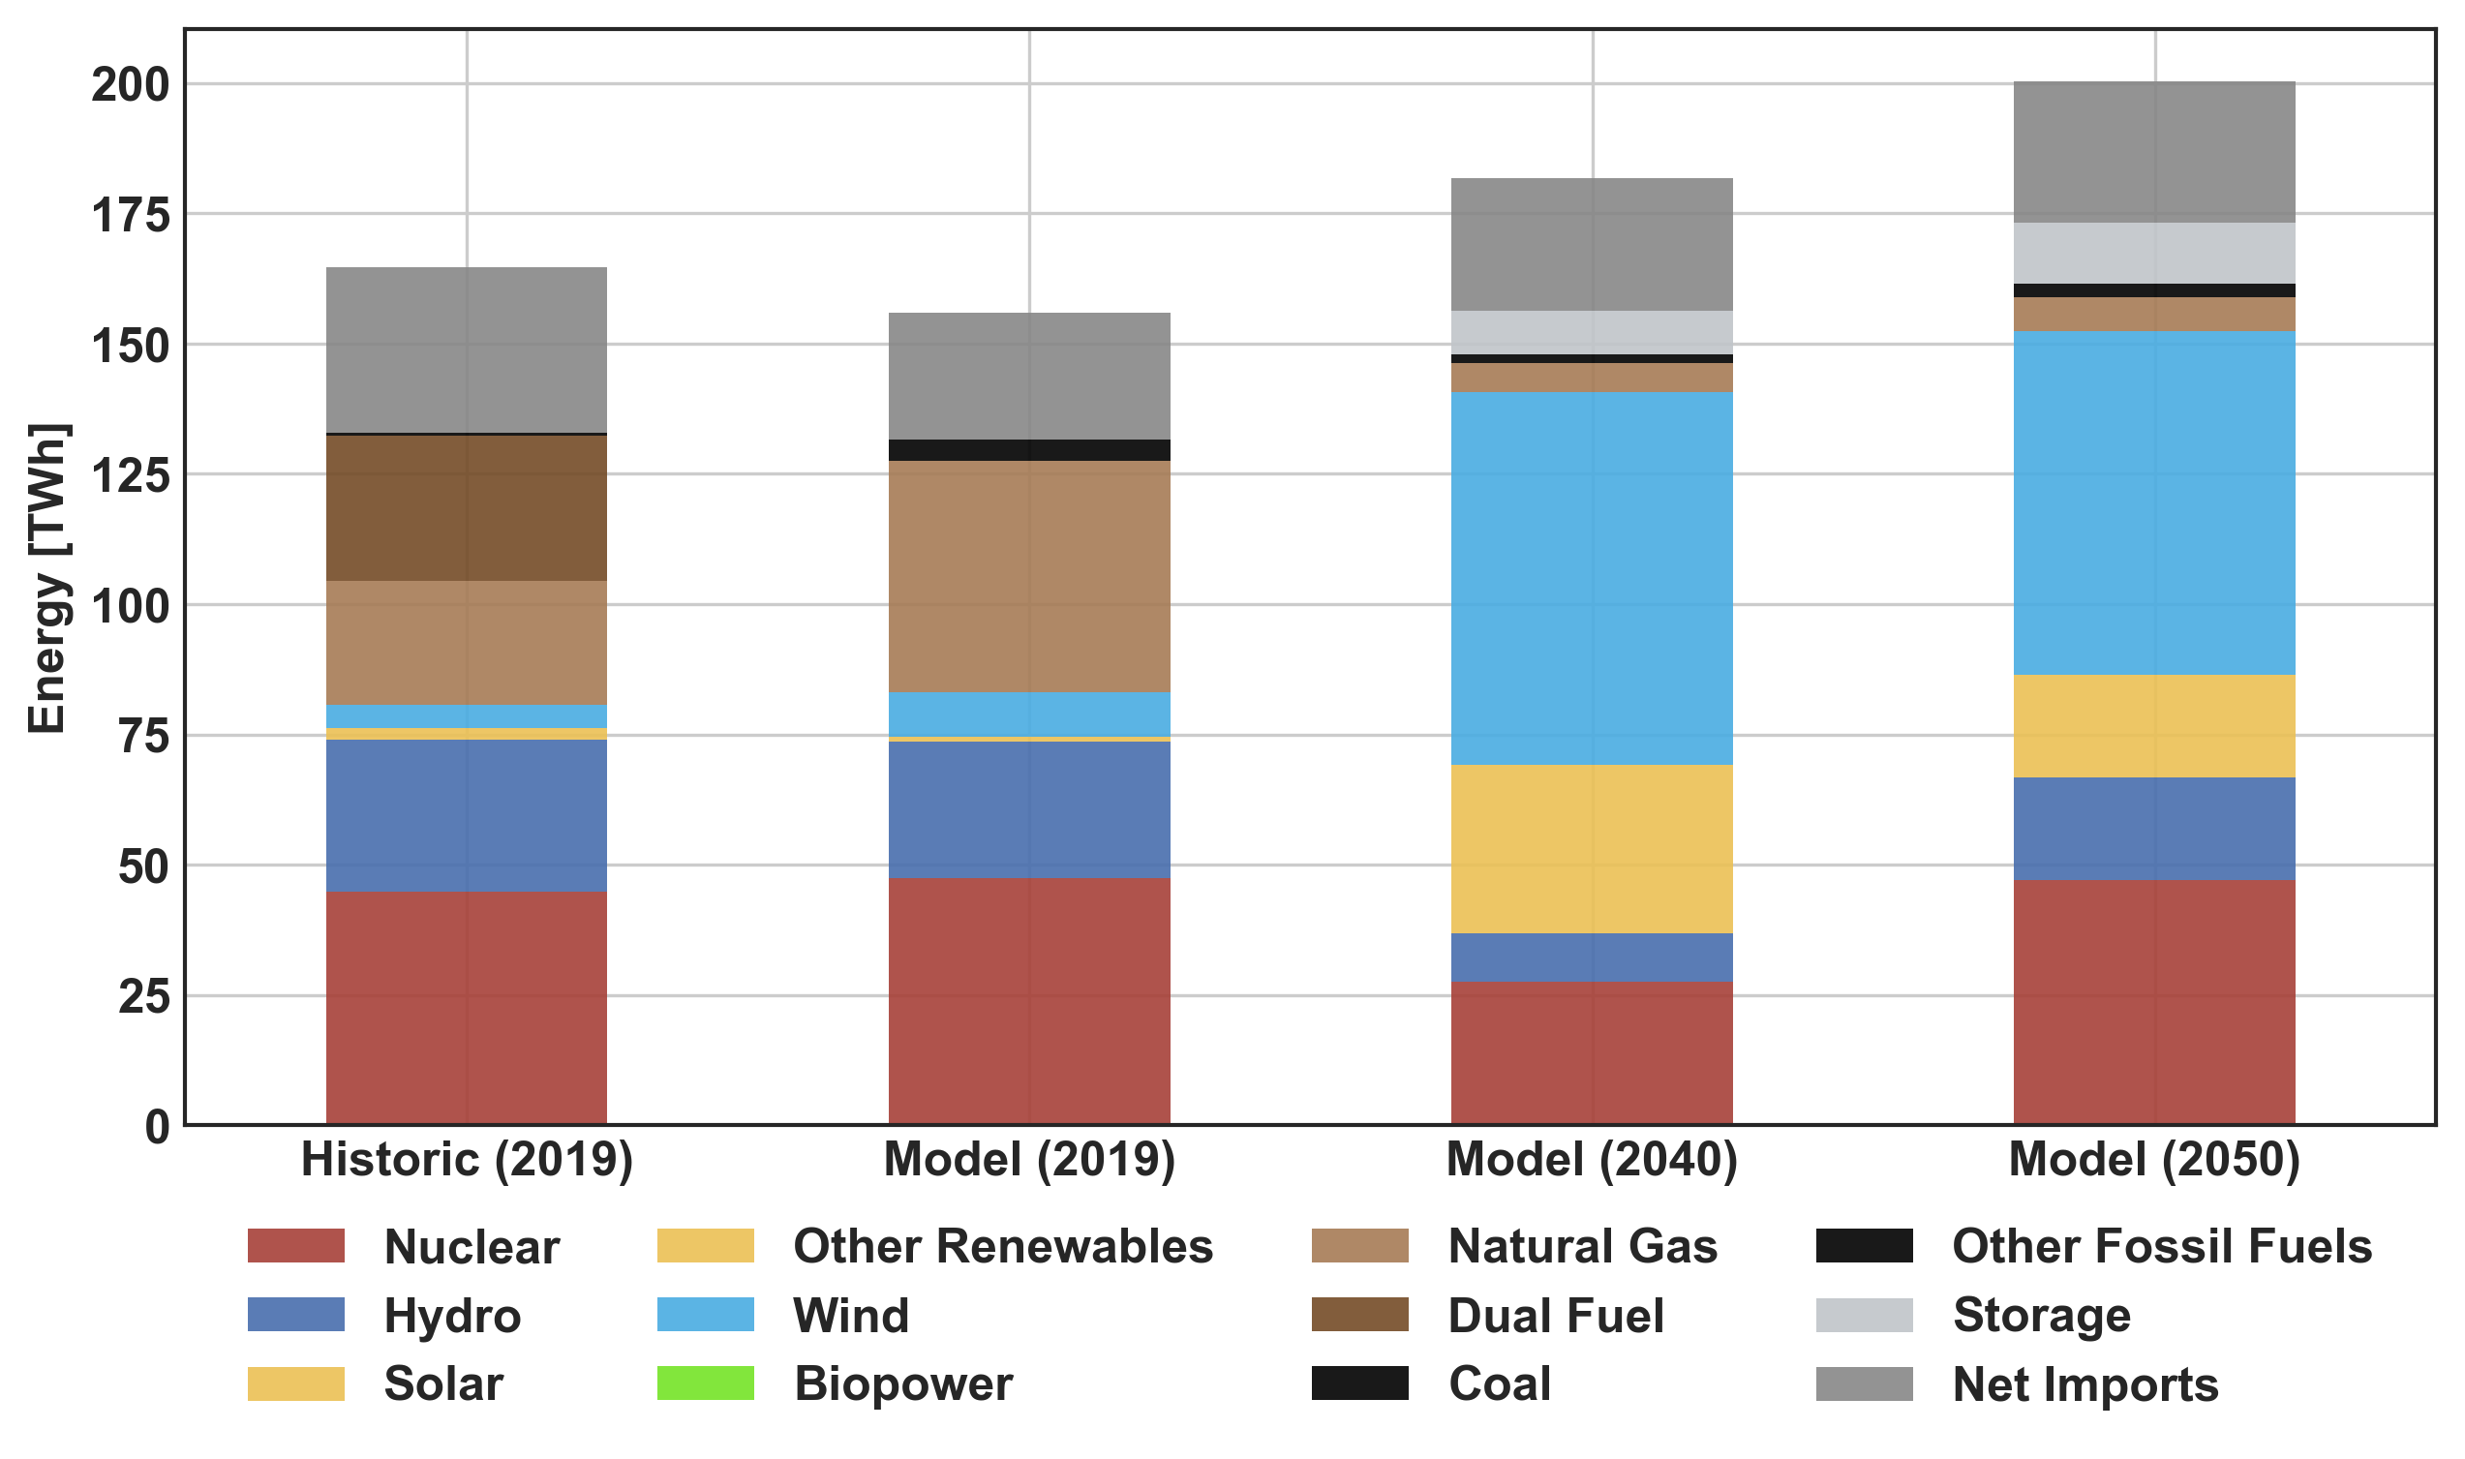
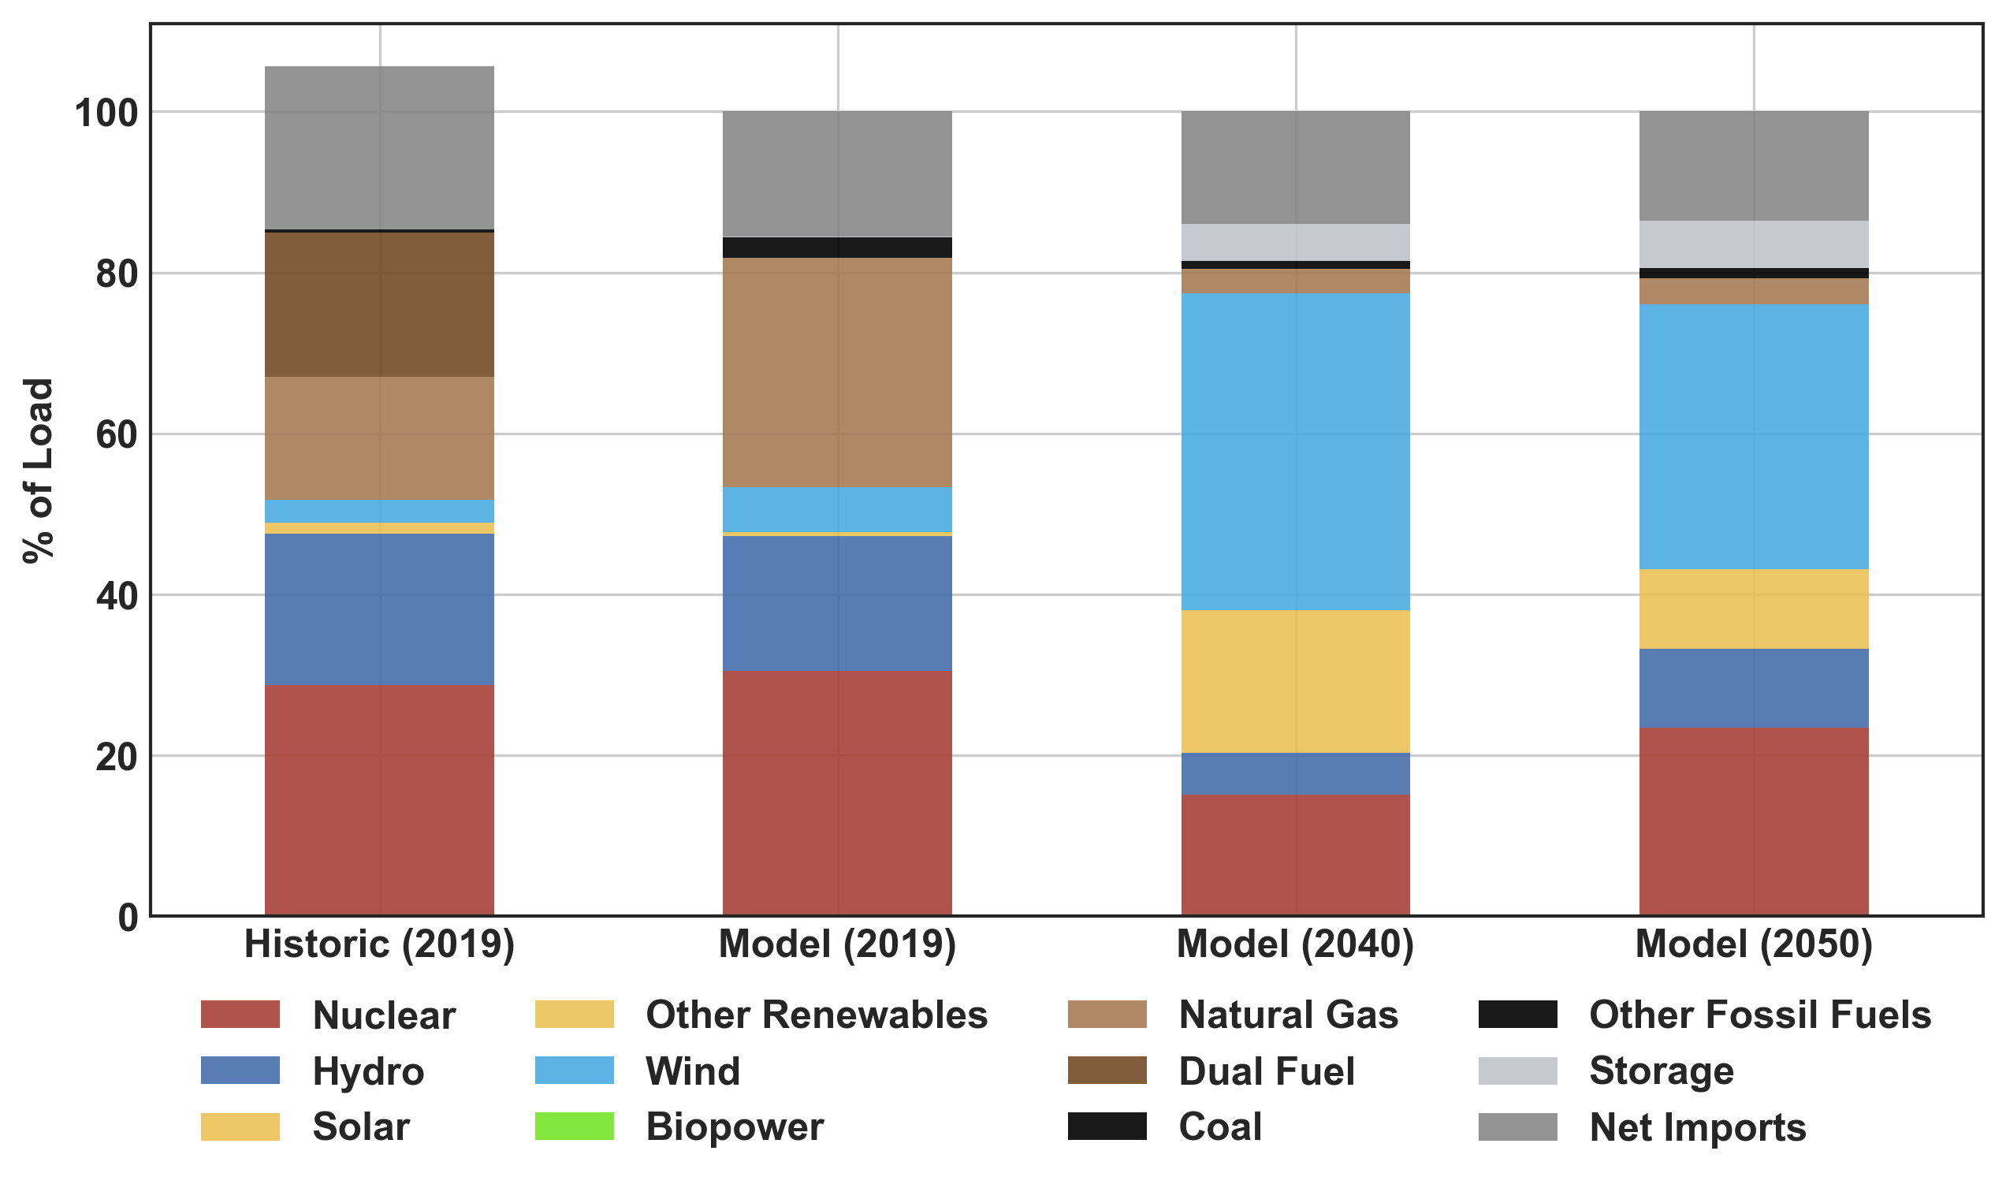
Energy Mix Insights
Baseline Comparison: Model (2019) is similar to Historic (2019)
Wind becomes the dominate energy resource (39% in 2040)
Nuclear remains as a crucial resource and there is a significant reduction in natural gas use
Annual Generation
Notes:
Lets look at the energy mix insights now…
The first insight is that the baseline model that I built for 2019 performed very similarly to what happened historically – both in magnitude and in normalized form as on the right.
Explain why there are some slight differences (simulating how the system in place in 2019 would have operated under the economic and weather activities of 2013)
On the normalized side you can see that in the historic data, the imports bring the total over 100%, and this seems to due to the fact that the under
2. Comparing the 2019 model to the 2040 and 2050 models, an important difference is that wind becomes the dominate energy source. (39% and 33% in the 2040 and 2050 models).
3. Nuclear will continue to be an important source of baseload power – infract in the 2050 model there was unserved energy without it.
4. Notably there is also a large reduction in the amount of natura gas generation, it is my understanding that the trend across the country right now has been, that when it comes to building new generators utilities are usually going for natural gas because they are lower carbon. If that trend is also present in NY it might
5. Other fossil fuels, like coal play a very small role and it might even make sense to retire them completely in favor of natural gas generators if need be.

Slide 12
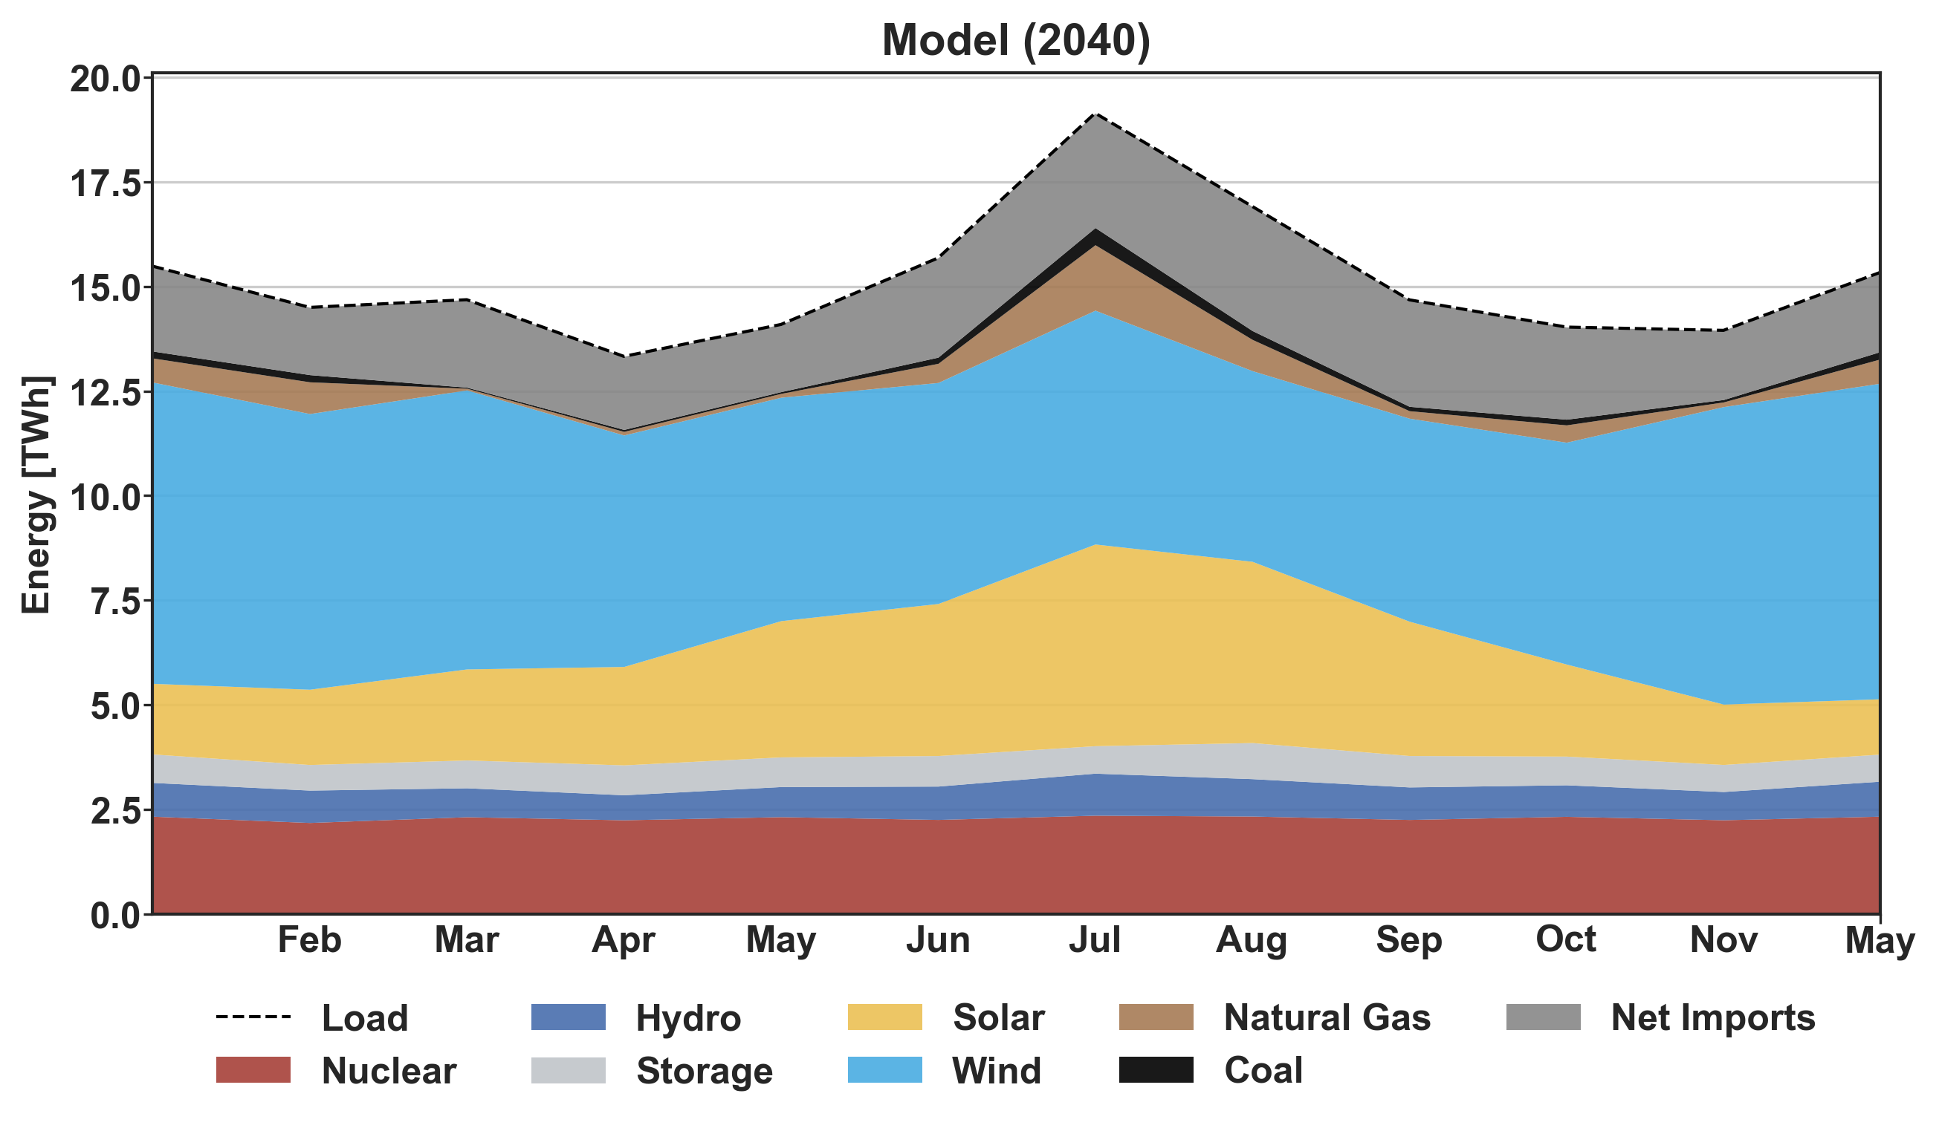
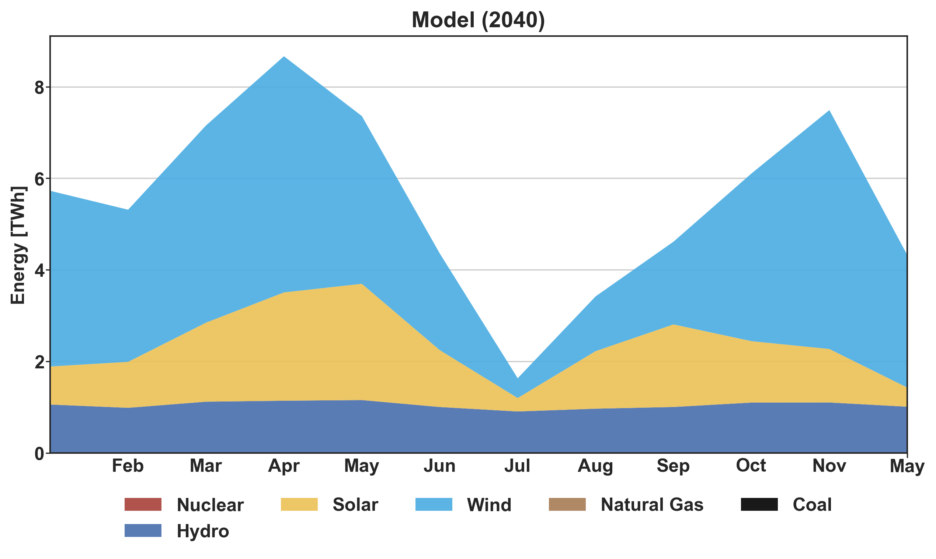
Curtailment Insights
Significant amounts of curtailment (36% in 2040 Model)
Seasonal supply and demand mismatch underscores need for seasonal storage
Generation (2040)
Curtailment (2040)
Notes:
Moving on to insights about the curtailment of renewable energy resources. Curtailment is simply the energy that is available from wind and solar but is lost because there isn’t enough load to serve and there is nowhere to store it.
There is significant amount of renewable curtailment in the 2040 and 2050 models. This graphic shows the amount of energy that was consumed every year for each model, with the amount of curtailment immediately next to it. If you focus your attention on the 2040 model, The curtailment of renewable sources in the 2040 model amounted to about ~36% of the total statewide load, which could have been used to help the state achieve the goals and become an exporter of clean energy to surrounding regions.. You can see that if you stack the amount of curtailment in the 2040 model on top of the energy stack next to it, you could serve all of the load from these sources.
So lets take a more granular look to see why this is happening. So the problem is that there is a supply and demand mismatch happening on multiple timescales – including seasonally that can be tackled by increasing the flexibility of the system with seasonal storage.
To take a more granular look at the seasonality of resource and load, we scan see the generation on the left, where the sum of generation for each month is equal to the load. There is peak demand in the summer months due to electric air conditioning, and lower the rest of the year since most heating is not electrified. We can see there is peak solar production in the summer, which conisides with minimum wind protection- but the wind picks up the rest of the year that there is less soalr resource.
On the right we can see the amount of energy that was curtailed, and we can see that the sthe most curtailment happens when the load is the lowest underscoring the need to find a way to store this energy for the long term to use during months with peak energy needs.
- These graphs show the seasonal generation on the left and amount of curtailment on the right. You can see that there is peak solar production in the summer, and that’s when there is the lowest curtailement,
Demand response programs could play a role in helping to reduce this curtailment.

Slide 13
Resource and Net Load Insights
Resource Availability
Supply/demand mismatch: Peak VRE at noon, but peak load is currently at 6 pm
Increased coupling of power system with weather -> need for sources grid flexibility: storage, demand management, peaking resources, etc.
Load and Net Load
Load
Net Load
Net Load w/o
Curtailment
Notes:
Wind and solar are considered variable renewable energy resources because they vary significantly throughout the day, something like hydro power is still renewable but not as variable.
Peak VRE occurs during the day, peak solar around noon , but peak wind around 7-8pm. The dotted line shows what the contour would be if none of the energy got curtailed.
If we compare the resource availability with the demand that exists in 2019, well see that there is a supply and demand mismatch. Peak load in 2019 was around 6PM, when there is relatively low resource.
When your system includes storage the shape of the load curve changes, which is why the 2040 model has a different shape with more load in the morning.
The solid blue line shows what the load curve looks like when you subtract out the VRE generation… it looks pretty flat… but the dotted line shows what it would be if no energy was curtailed and the energy was immediately used instate or exported (not stored, which would increased load). Under this system the remaining resources would have to ramp up quickly to meet demand- so we would need to have generators or storage that could meet this steep increase in demand.

Slide 14
Battery Storage Insights
VRE Availability
Batteries charge during peak resource & reduce curtailment
Batteries discharge when there is low resource and increasing load
More storage will be needed (capacity and duration)
Battery Operation
Discharging
Charging
Notes:
Insights and answered questions up front! The how comes later…

Slide 15
Transmission Insights
Transmission capacity will need to be increased 2-5x to aid grid flexibility
There could be power interruptions without increasing transmission capacity
Notes:
Transmission capacity between upstate will need to be increased 2-5x to aid grid flexibility
Without increasing transmission, there might be power interruptions

Slide 16
Economic Insights
Annual and average production costs could reduce to ~20% of the current costs
Reduced production costs would eventually be reflected in lower retail electricity prices
Total Production Cost
Average Production Cost
Notes:
a generation cost comparison between the models, which indicates that the costs could decline to 22 or 32% respectively relative to the 2019 model costs.
According to Plexos documentation the total generation cost includes fuel, VO&M, start and shutdown costs and emissions costs. However, only fuel and VO&M costs were included in the constructed models

Slide 17








Datasets
NREL Wind Toolkit
Technoeconomic Dataset (2014)
EIA 860
(2019er)
Generators
Wind
NREL ATB
(2019)
NREL NSRDB + SAM (2014)
Costs
Solar
NYISO Grid Data and Goldbook
(2014 & 2019)
ORNL HydroSource
(2020)
Load and I&E
Hydro
Notes:
Attributions
Generator by Adrien Coquet from the Noun Project
Power Lines by Nikita Kozin from the Noun Project
sales report by joe pictos from the Noun Project
dollar by Alice Design from the Noun Project
solar by Andrejs Kirma from the Noun Project
Wind by Justicon from the Noun Project
hydro power by priyanka from the Noun Project

Slide 18



Software Libraries
NYISOToolkit
Github
PlexosToolkit
PlexosDBGenerator
Create Plexos Power Systems
NYISOData
Access NYISO Data
PlexosResults
Simulation Visualizations
NYISOStat
Calculate Statistics
NYISOVis
Historical Visualizations
Python
Transformation and Analysis
Featured in Python Weekly Issue 460!
Notes:
Pipeline
Attributions
Cylinder by Sebastian Belalcazar Lareo from the Noun Project
py by Muhammad Darwisy Alfarizi from the Noun Project
weather by Sumit Saengthong from the Noun Project
Network by Pause08 from the Noun Project
CSV by JunGSa from the Noun Project
Flame by DinosoftLab from the Noun Project

Slide 19
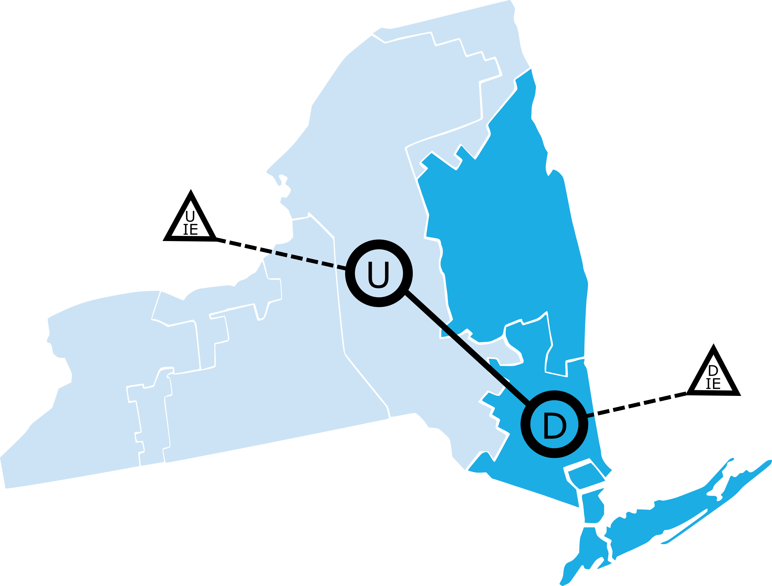
Nodal Model
Details
2 Nodes: Upstate and Downstate
Grouped External Interface Flows
Internal Interface Flow: ‘Total East’
Notes:
- 2 nodes model, with upstate and downstate region consistent with the NYISO definition. Nodes are points that have an associated load profile, and you can attach generators to these nodes – essentially assuming that the generators are colocated
generators were added to each node based on the county they were located in according to EIA DB
External interface flows were grouped into upstate and downstate region
The internal interface flow limit for 2019 was set at 4080 based on a NYSIO study, but this limit was increased for 2040 and 2050 model.

Slide 20

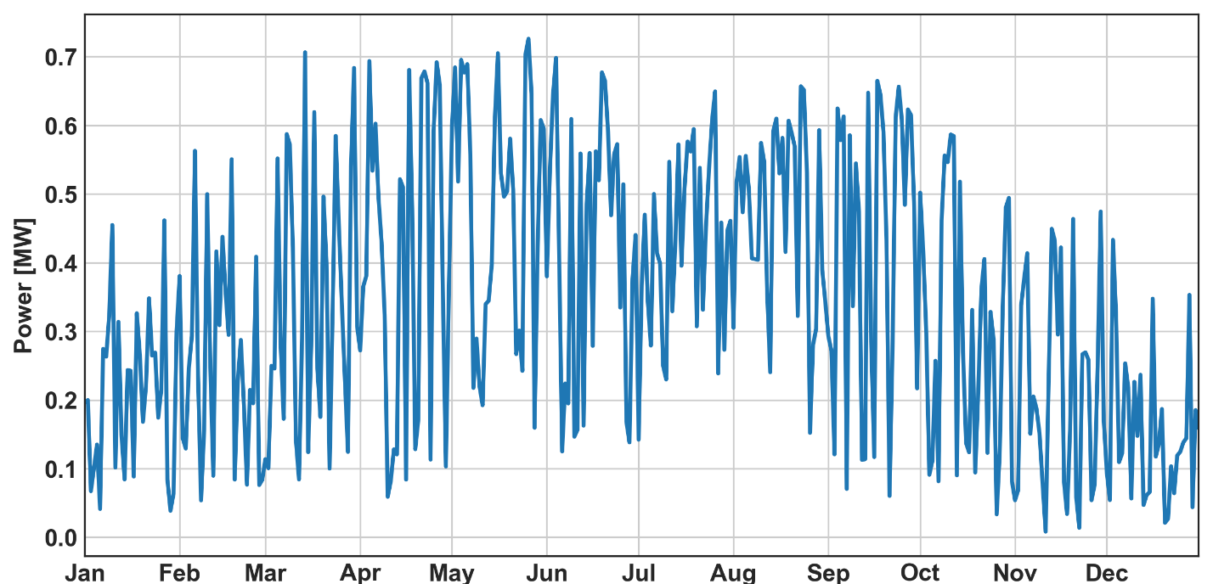

Generator Modeling
- Coal: New
- Gas: CT
- Gas: CC
- Nuclear
- Biopower: Dedicated
- Wind: Onshore
- Wind: Offshore
- Photovoltaics
- Conventional Hydroelectric
- Pumped Storage
- Battery Storage
2013 hourly time series used for solar and wind production
Fuel-based
Example: Gas CC
Property | Value | Units
Units | 1 | -
Rating (M1-4,10-12) | 164.2 | MW
Rating (M5-9) | 169.7 | MW
Minimum Stable Level | 115 | MW
Emissions (CO2 ; Hg ; NOx ; SO2) | 117; 0; 0.02; 0.0033 | lb/MMBtu
Heat Rate | Datafile (6420.8) | Btu/kWh
Fuel Price | Datafile (2.77) | $/MMBtu
VO&M Charge | Datafile (3.2) | $/MWh
Wind
Operation
ATB GENERATOR TECHNOLOGIES
Solar
SRMC
Hydro
Technical Life | 55 | yr
Max Energy Year | 2 | GWh
Batteries
Source: NREL ATB Mid Cost Scenario and Avg CF

Slide 21
Conclusions and Future Work
Conclusions
Constructed and validated a power system model for 2019
Constructed two future models to analyze the feasibility of achieving decarbonization goals
NY could evolve to have 20% of the emissions and 20% of the operational cost of current system
NY could achieve its goals with more storage and demand management for temporal flexibility, and transmission for geographic flexibility
Wind could become dominate energy source, nuclear could be needed, and natural gas use could decline
Published an Open Source Library: NYISOToolkit
Future Work
Market-based imports/exports model
Model demand response
Supply curve approach for solar and hydro
Capacity expansion model

Slide 22
Q/A

Slide 23
APPENDIX A

Slide 24
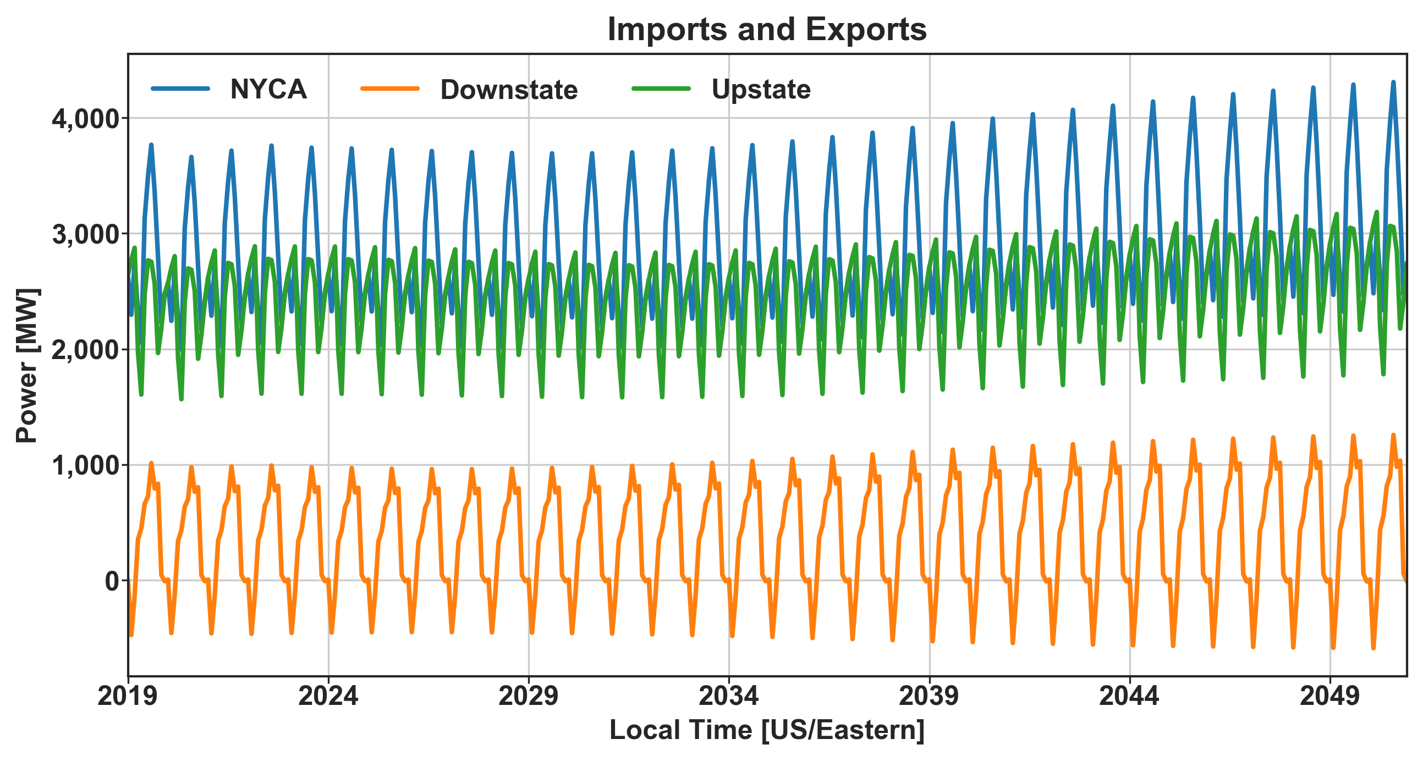
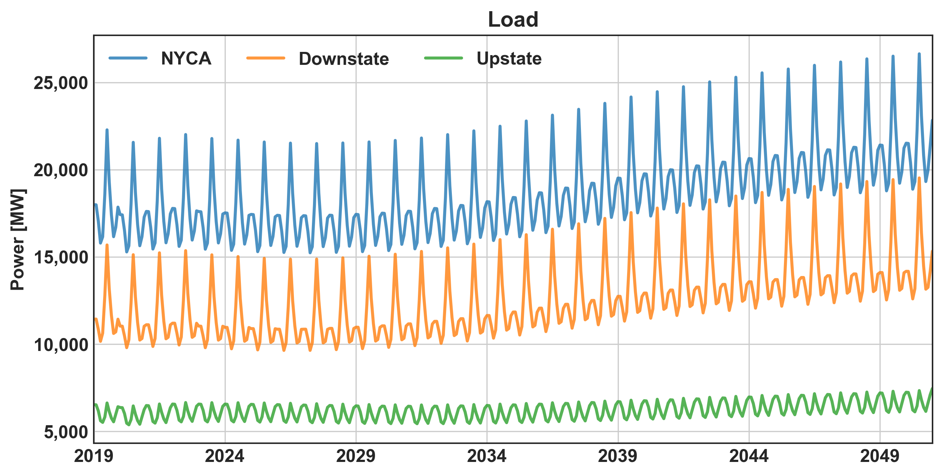
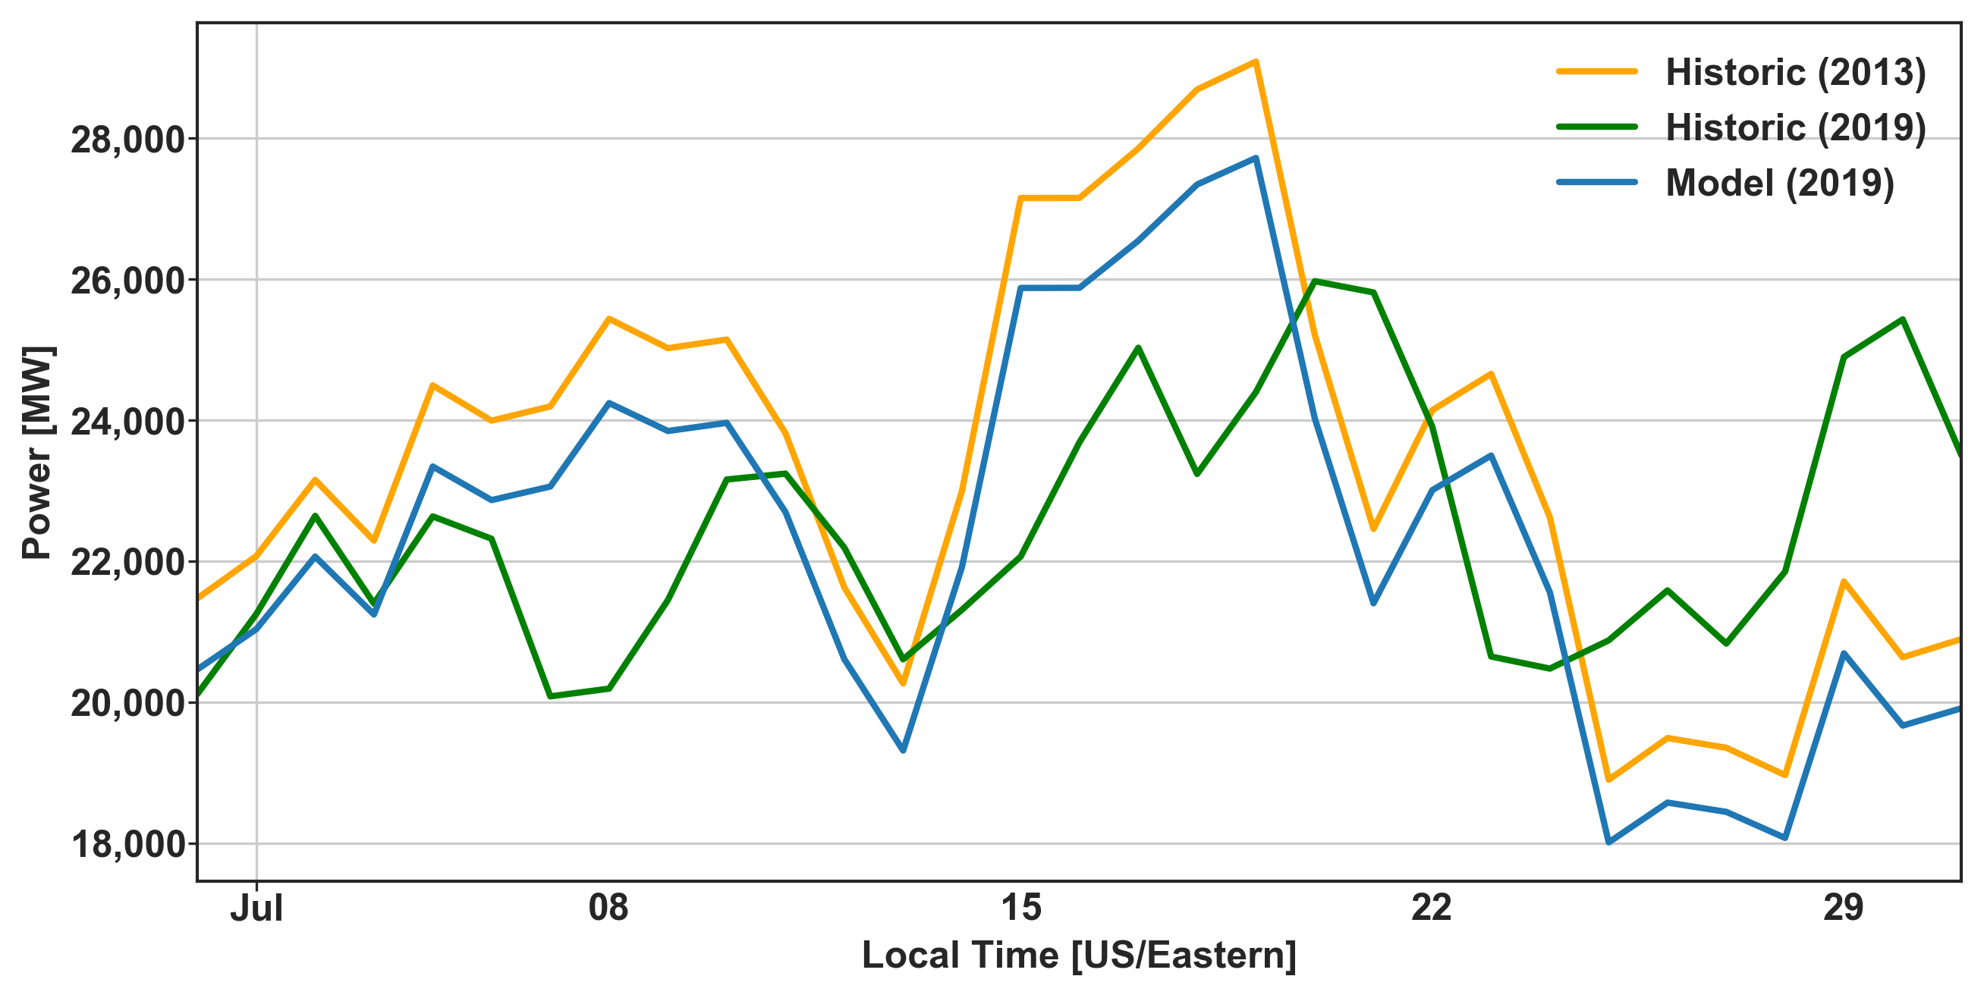
Load and I&E Modeling
Notes:
Electricity demand is influenced by human activities and weather variables such as temperature. For example, when it is hot outside there tends to be more demand for electric air conditioning than there is on a cooler day. The weather also affects the supply of electricity, especially from renewable energy resources which depend on wind and solar radiation. Since load and renewable resource availability is coupled by weather, power system studies with renewable energy resources should use time-synchronous resource and load data.
The latest time synchronous data that I could find across all the relevants datasets was 2013, so I had to recreate a new load and i&e curves as follows….

Slide 25
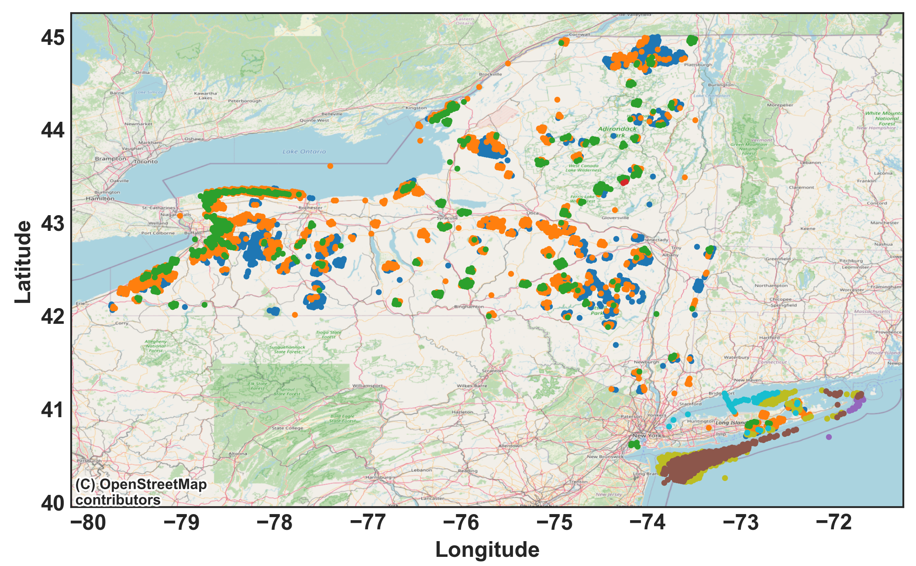
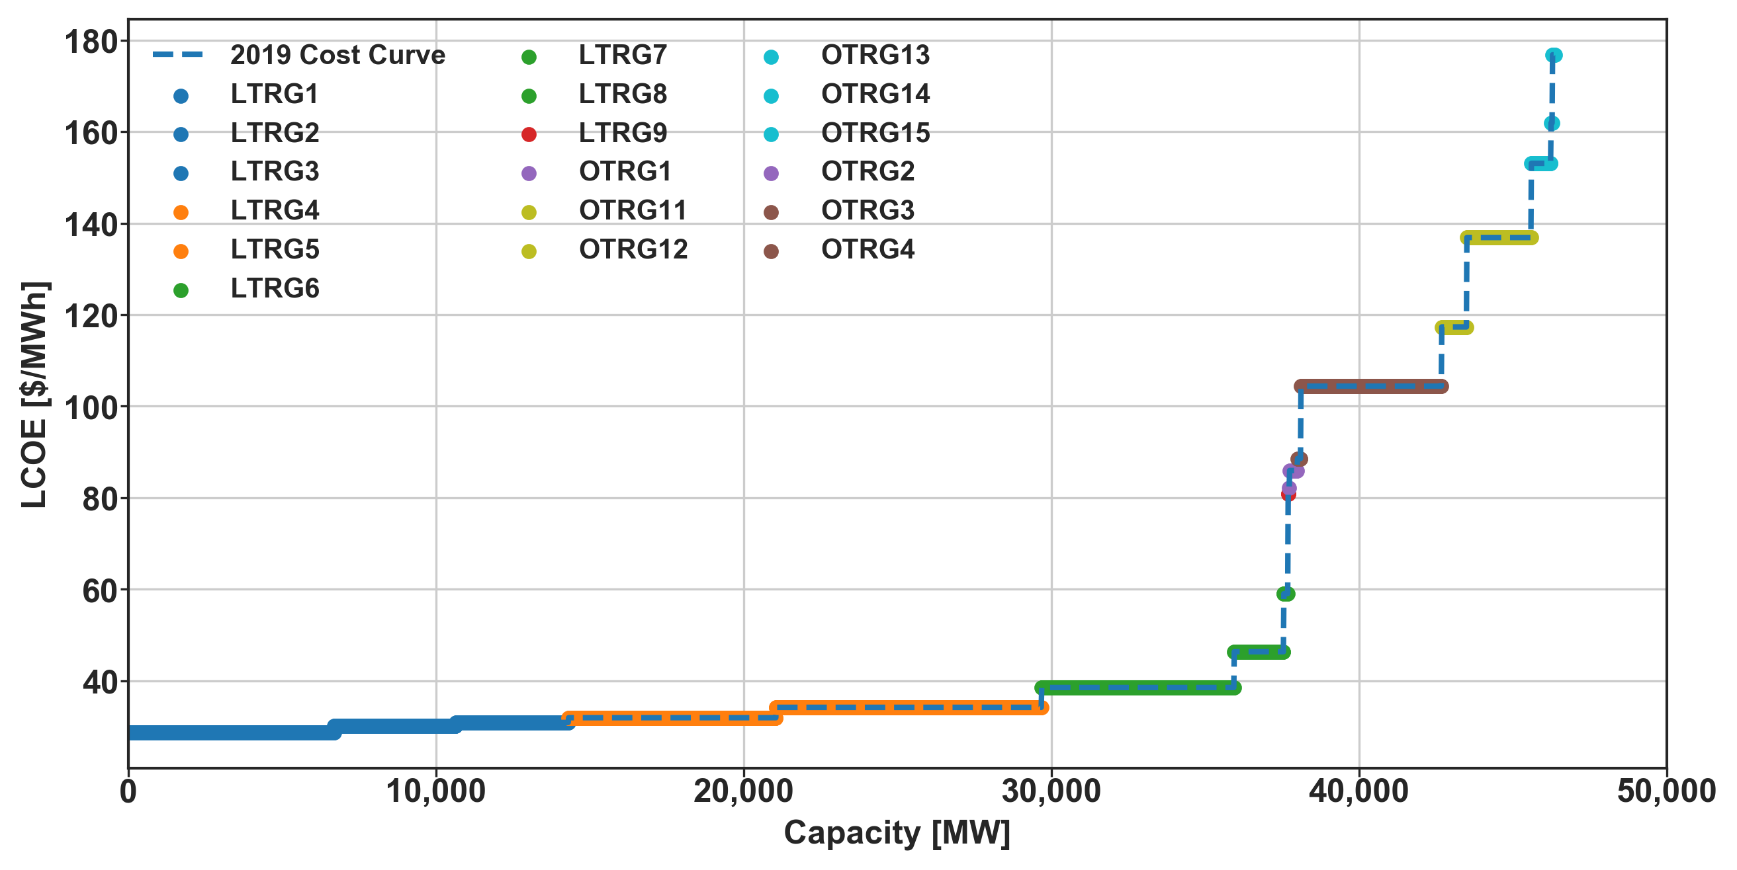
Wind
make updated figures
NREL Windtoolkit
Technoeconomic Dataset (2014)
Notes:
Add power output?

Slide 26
Capacity Comparison
Technology | 2019 Historic | 2019 NY Model | 2040 McKinsey Model | 2040 NY Model | 2050 NREL Model |  | 2050 NY Model
Hydro | 4,692 | 4,682 | 5,800 | 5,786 | 4,615 |  | 4,682
Wind | 1,991 | 1,987 | 27,500 | 27,510 | 22,630 |  | 22,630
Solar | 474 | 474 | 28,800 | 28,810 | 14,094 |  | 14,090
Nuclear | 5,709 | 5,709 | 3,300 | 3,154 | - |  | 5,709
Gas | 24,565 | 28,003 | 21,700 | 21,815 | 15,494 |  | 16,011
Coal | 1,415 | 1,415 | 700 | 993 | 1,021 |  | 993
Biopower | 128 | 560 | - | - | 19 |  | 19
Storage | 1,293 | 1,273 | 5,000 | 5,000 | 11,622 |  | 11,622
Other | 3,862 | - | 3,200 | - | - |  | -
Total | 44,130 | 44,102 | 96,000 | 93,068 | 64,880 |  | 75,756
Notes:
^{[1]} Nameplate Capacities were used from the EIA860 database [29]
^{[2]} Includes the hydro generators installed in 2019 (EIA860 DB) and 1104 [MW] new capacity (See Section 4.5.4 )
^{[3]} No offshore wind included in 2019 NY Model. All the other models included offshore wind.
^{[4]} Includes 27,510 [MW] onshore and 8,656 [MW] offshore wind.
^{[5]} Includes 13,974 [MW] onshore and 8,656 [MW] offshore wind.
^{[6]} Concentrated Solar (CSP) was not modeled.
^{[7]} The NREL Standard Scenario assume there is no nuclear in New York State in 2050.
^{[8]} The NREL model did not specify any nuclear but running the system without it resulted in unserved energy. After unserved energy was observed again when running with the addition 3,154 [MW] of nuclear (specified by the McKinsey model)– the existing (2019) amount was used - resulting in no unserved energy.
^{[9]} Consists of 20,334 [MW] Gas CC and 7,669 [MW] Gas CT.
^{[10]} 14,899 [MW] of Gas CC and 6,916 [MW] of Gas CT was included.
^{[11]} 12698 [MW] of Gas CC and 3,314 [MW] of Gas CT was included.
^{[12]} The McKinsey report categorized biopower into the ‘Other’ category together with flexible loads and oil.
^{[13]} Storage includes pumped hydro storage and battery storage. Flywheel storage was not modeled.
^{[14]} Includes 33 [MW] of four-hour battery storage, the rest was existing pumped hydro storage (See Sections 4.6.1 and 4.6.2
^{[15]} Includes 3,700 [MW] of 8-hour battery storage, the rest was existing pumped hydro storage (no new facilities modeled).
^{[16]} Includes 10,382 [MW] of 8-hour battery storage, the rest was existing pumped hydro storage (no new facilities modeled).
^{[17]} Petroleum generators in the EIA860 database were mapped to gas generators in the 2019 (See Section 4.5.1 ).
^{[18]} The McKinsey report categorized biopower into the ‘Other’ category together with flexible loads and oil.

Slide 27
Energy Comparison
Technology | Historic (2019) | Historic (2019) [% Of Load] | Model (2019) | Model (2019) [% Of Load] | Model (2040) | Model (2040) [% Of Load] | Model (2050) | Model (2050) [% Of Load]
Nuclear | 44.78 | 29 | 47.46 | 30 | 27.56 | 15 | 47.03 | 23
Hydro | 29.24 | 19 | 26.21 | 17 | 9.33 | 5 | 19.63 | 10
Wind | 4.47 | 3 | 8.61 | 6 | 71.57 | 39 | 66.01 | 33
Solar | - | - | 0.79 | 1 | 32.23 | 18 | 19.76 | 10
Other Renewables | 2.21 | 1 | - | - | - | - | - | -
Biopower | - | - | 0.00 | 0 | - | - | 0.00 | 0
Natural Gas | 23.76 | 15 | 44.51 | 29 | 5.61 | 3 | 6.44 | 3
Dual Fuel | 27.89 | 18 | - | - | - | - | - | -
Coal | - | - | 4.00 | 3 | 1.70 | 1 | 2.52 | 1
Other Fossil Fuels | 0.57 | 0 | - | - | - | - | - | -
Storage | - | - | 0.05 | 0 | 8.36 | 5 | 11.76 | 6
Total Generation | 132.93 | 85 | 131.62 | 84 | 156.35 | 86 | 173.16 | 86
Total Renewable Generation | 35.92 | 23 | 35.60 | 23 | 113.13 | 62 | 105.40 | 53
Total Carbon-Free Generation | 80.70 | 52 | 83.06 | 53 | 140.69 | 77 | 152.43 | 76
Net Imports | 31.71 | 20 | 24.29 | 16 | 25.48 | 14 | 27.21 | 14
Total Generation + Net Imports | 164.64 | 106 | 155.90 | 100 | 181.83 | 100 | 200.37 | 100
Load | 155.83 | 100 | 155.90 | 100 | 181.83 | 100 | 200.37 | 100

Slide 28
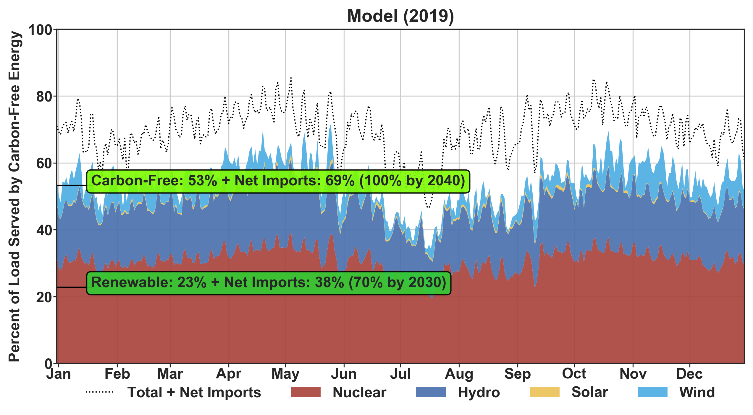
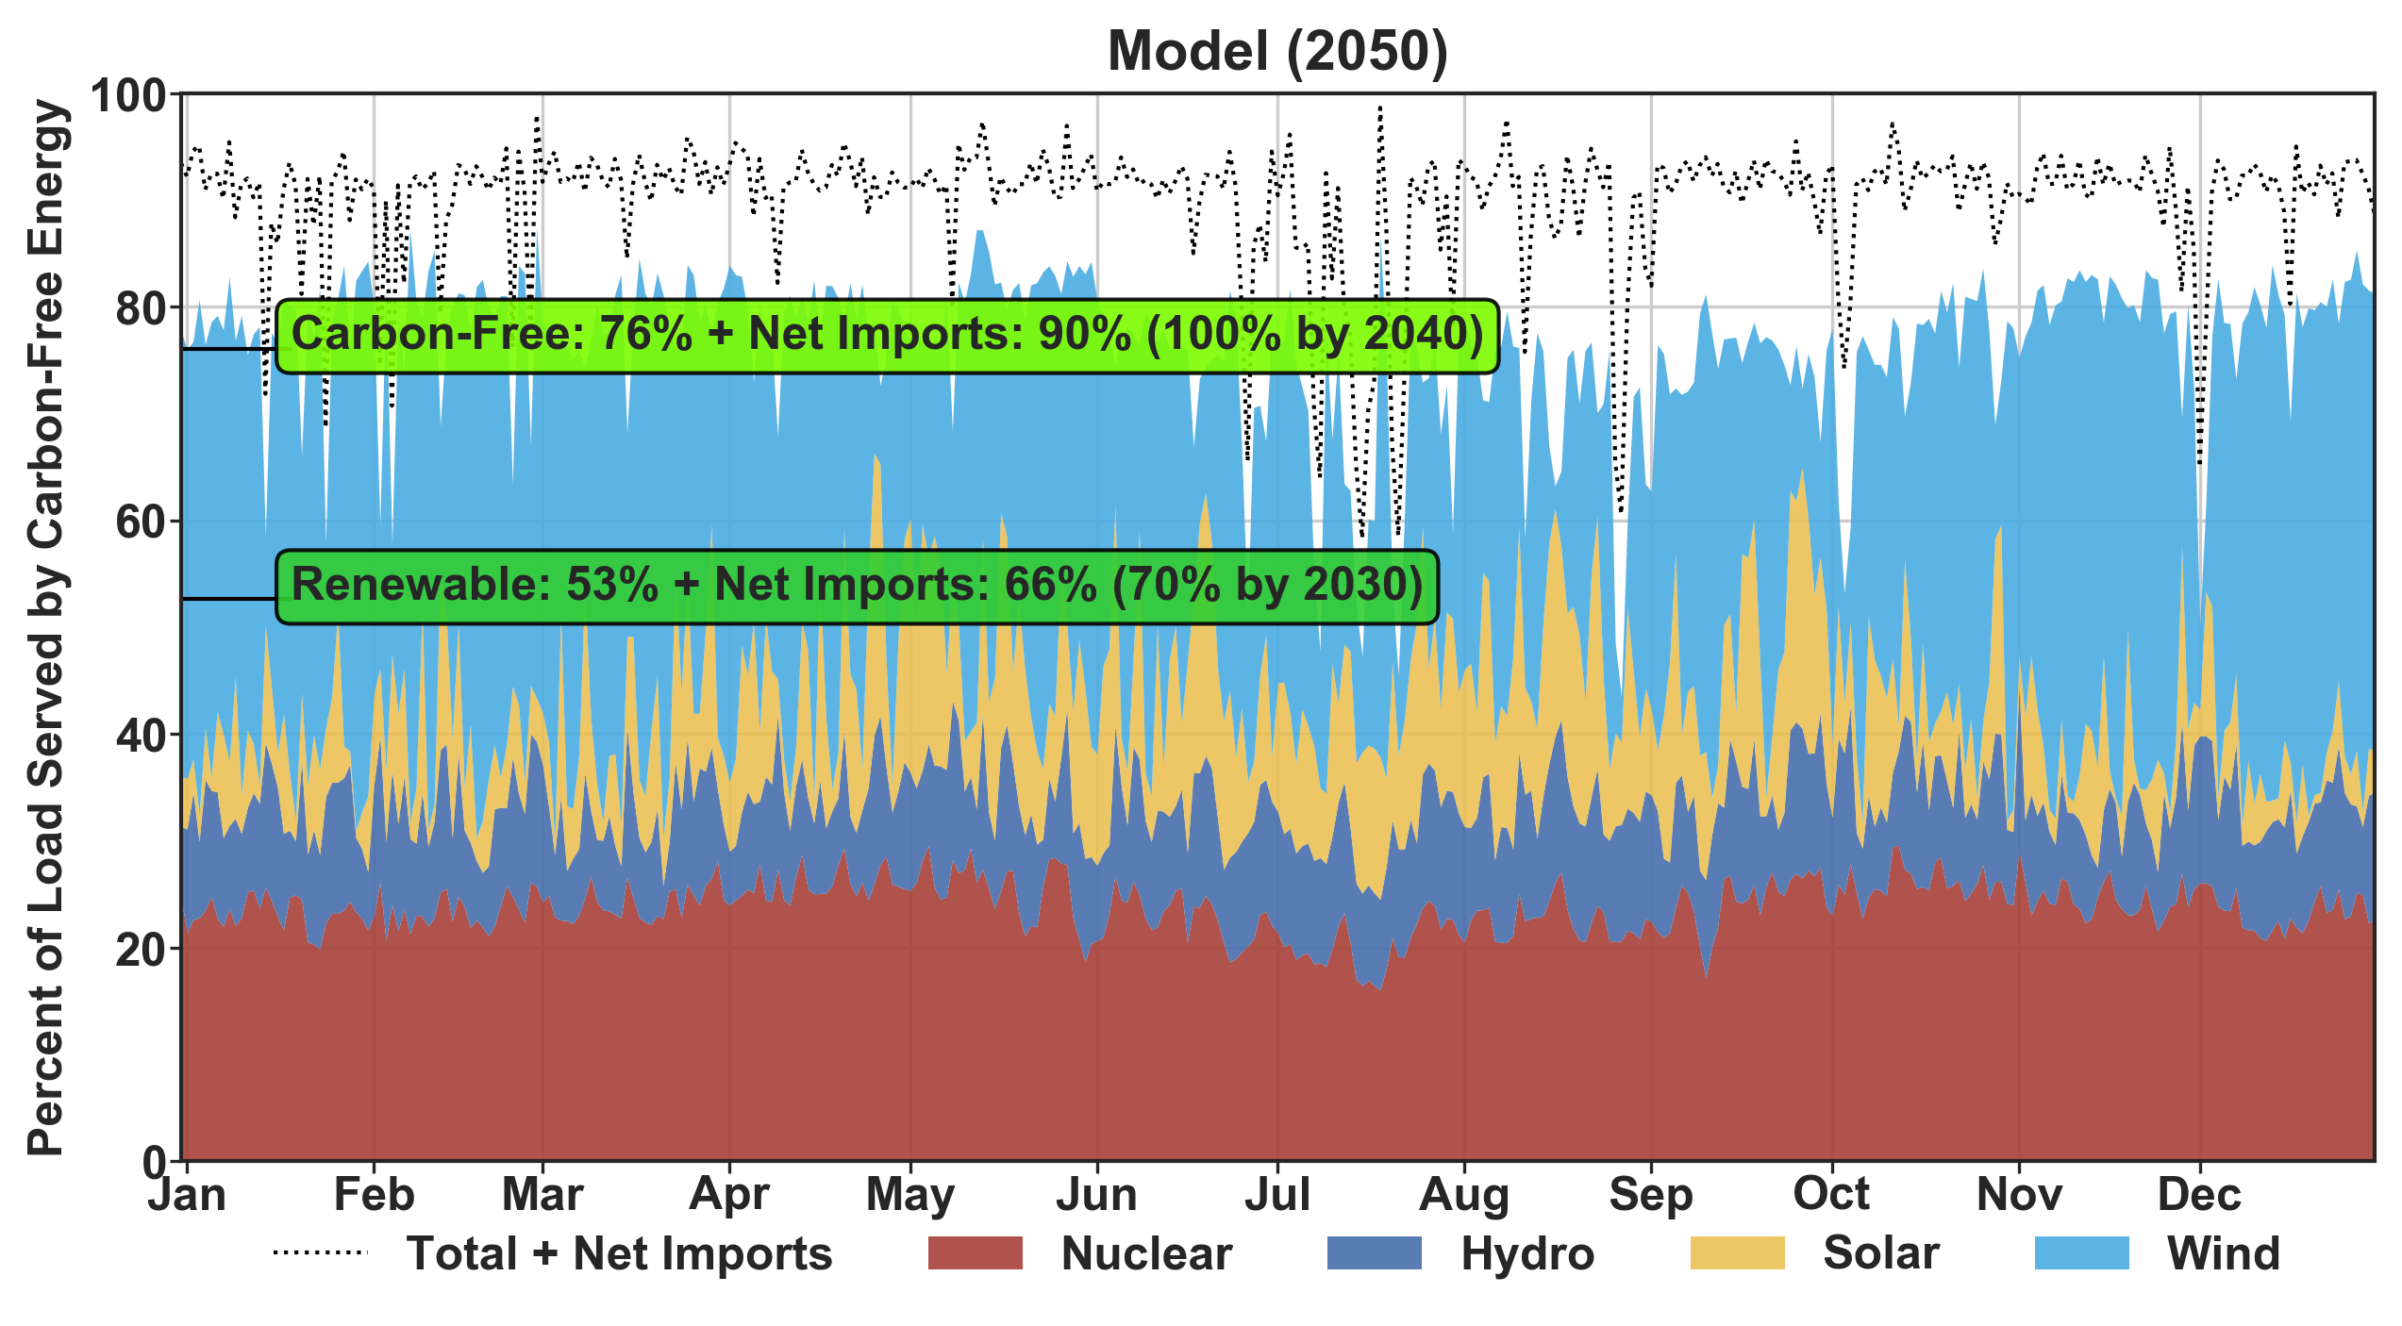

Slide 29
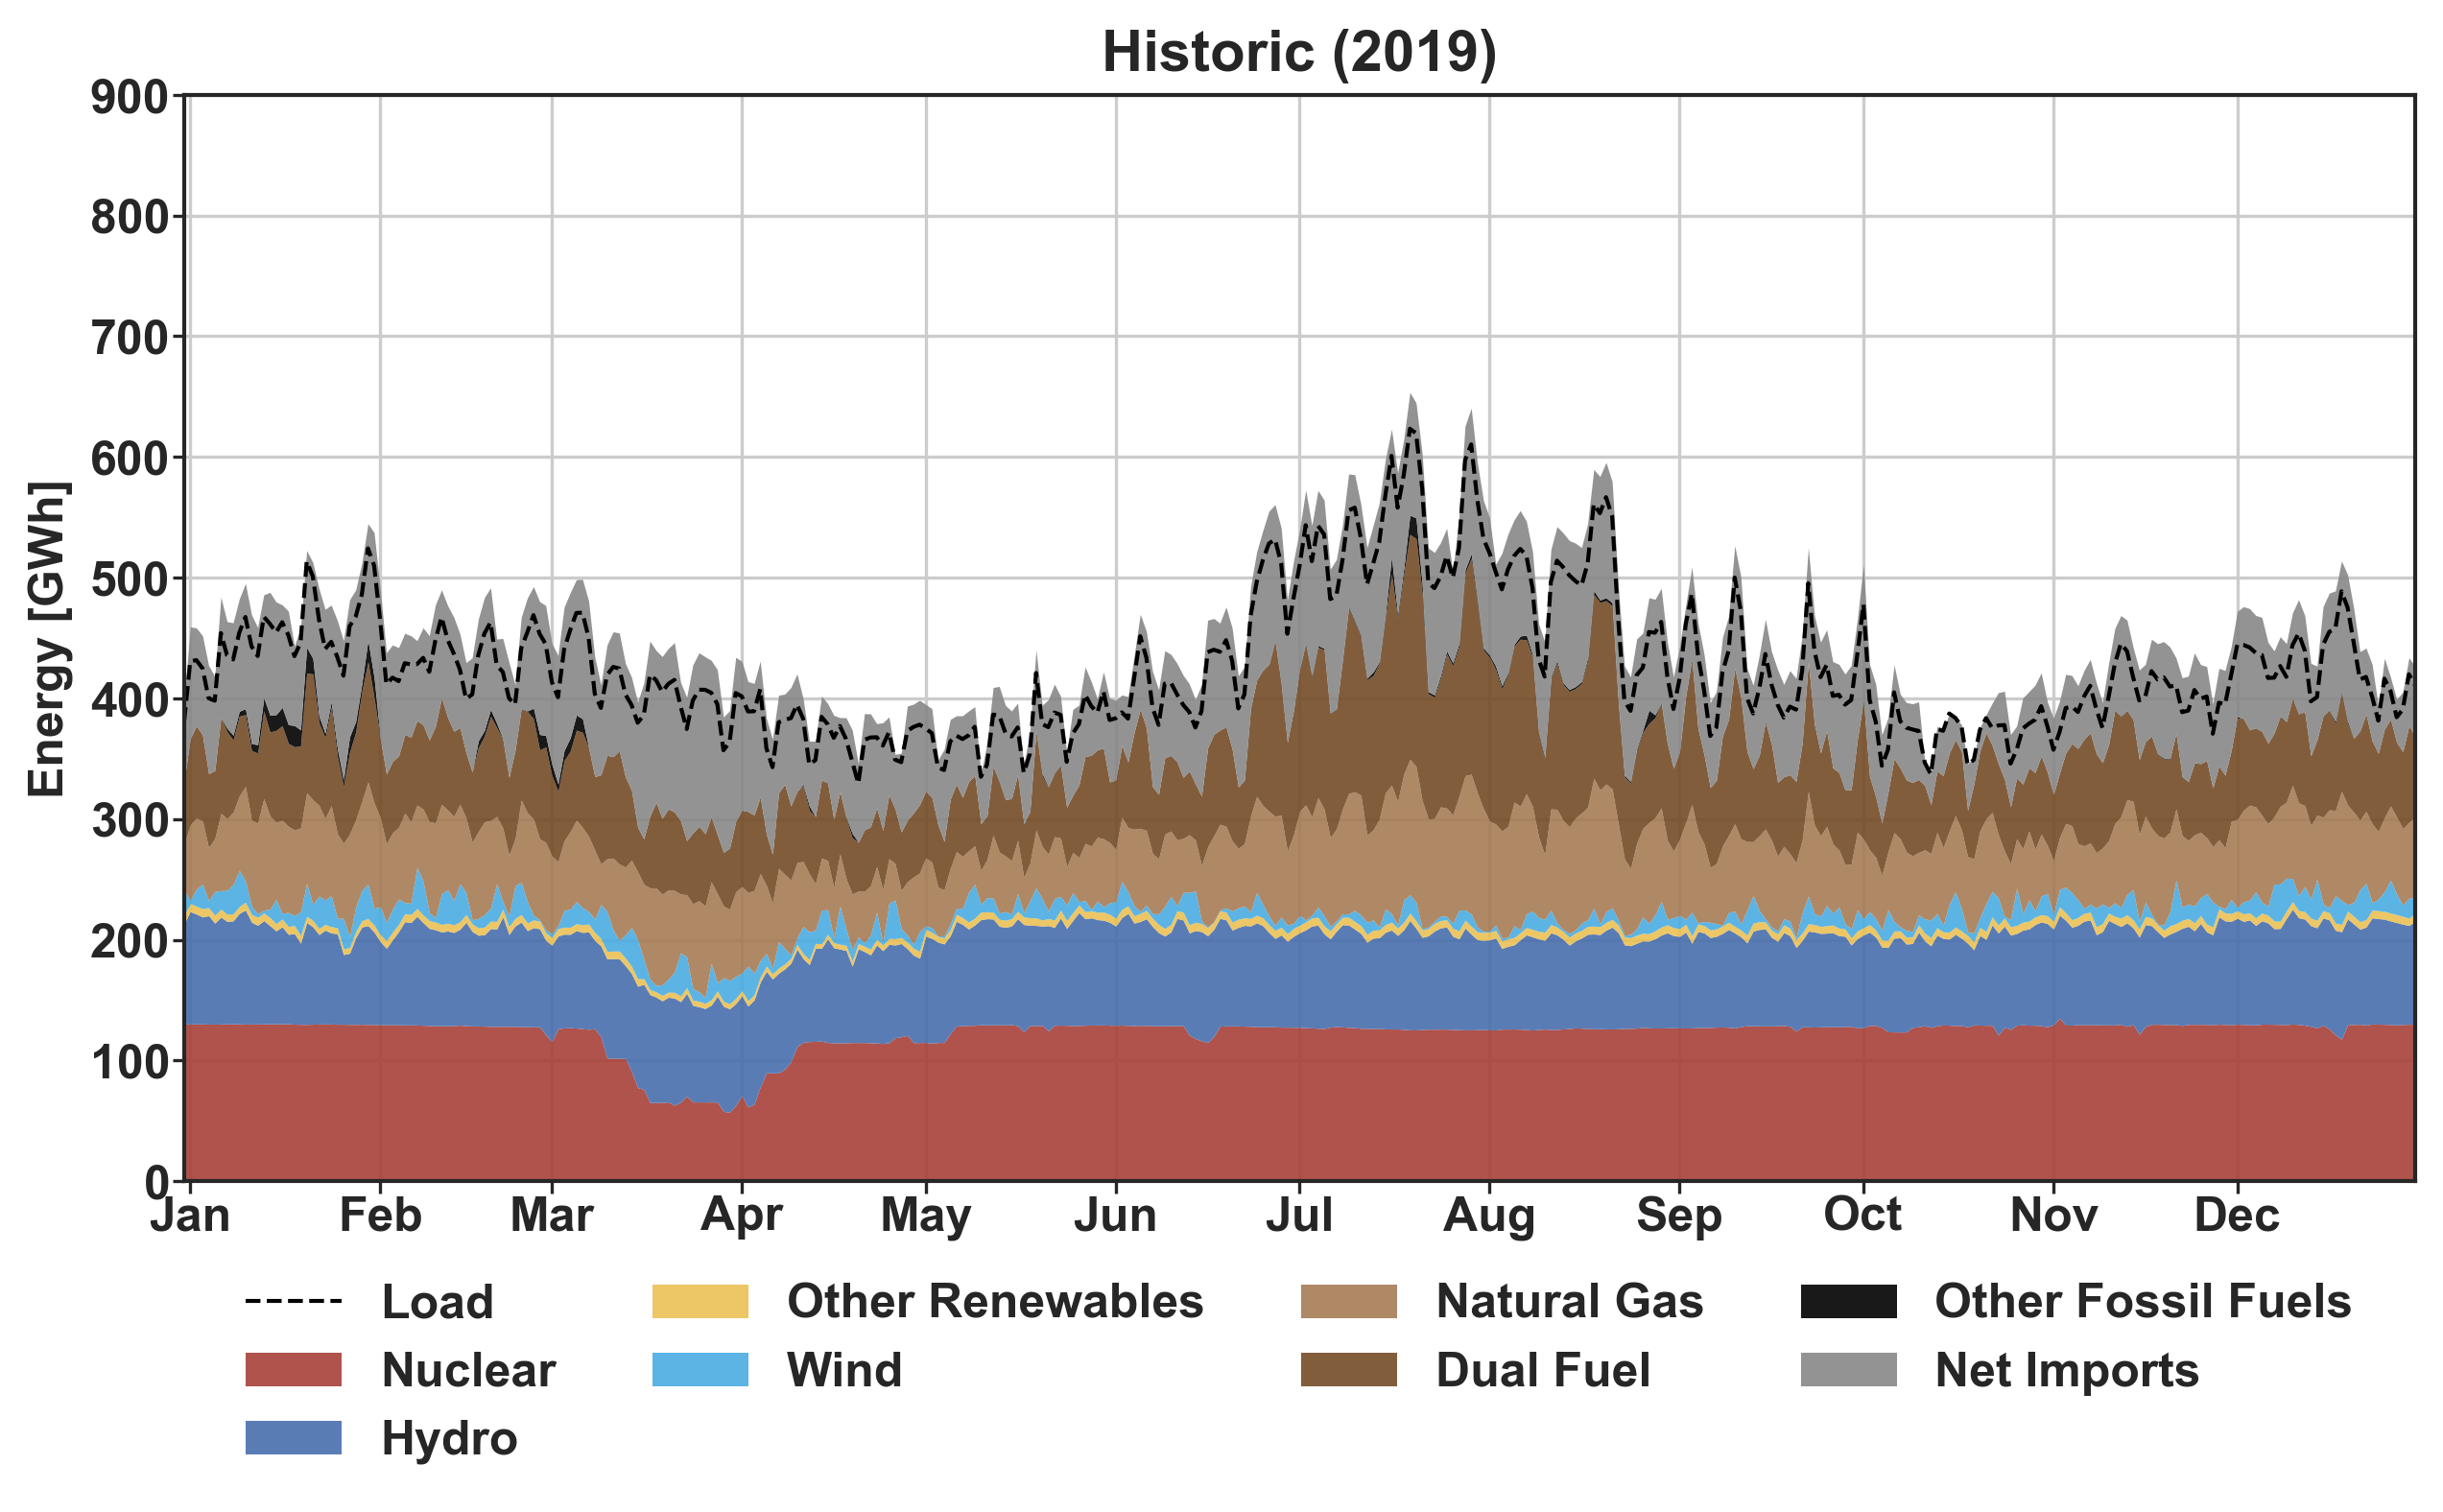
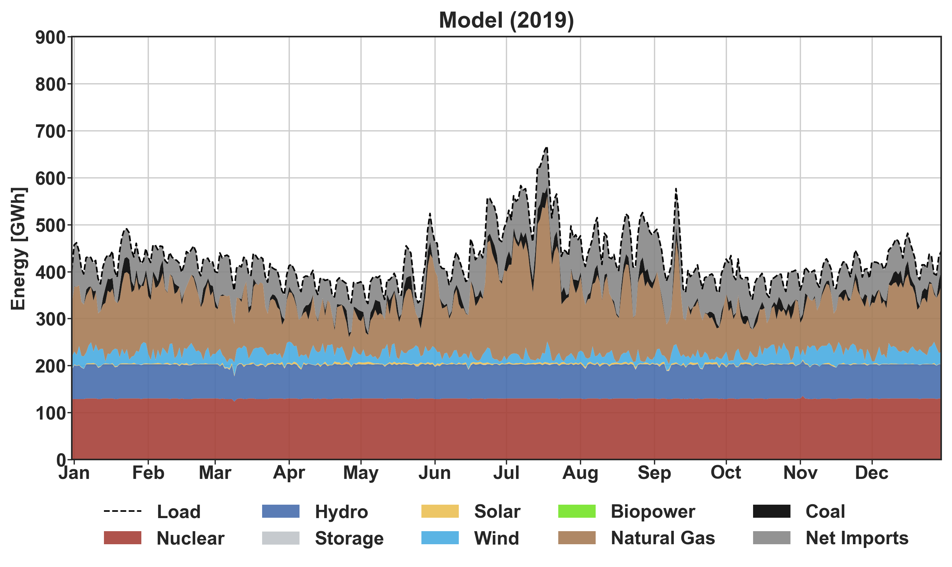
Historic (2019)
Model (2019)

Slide 30
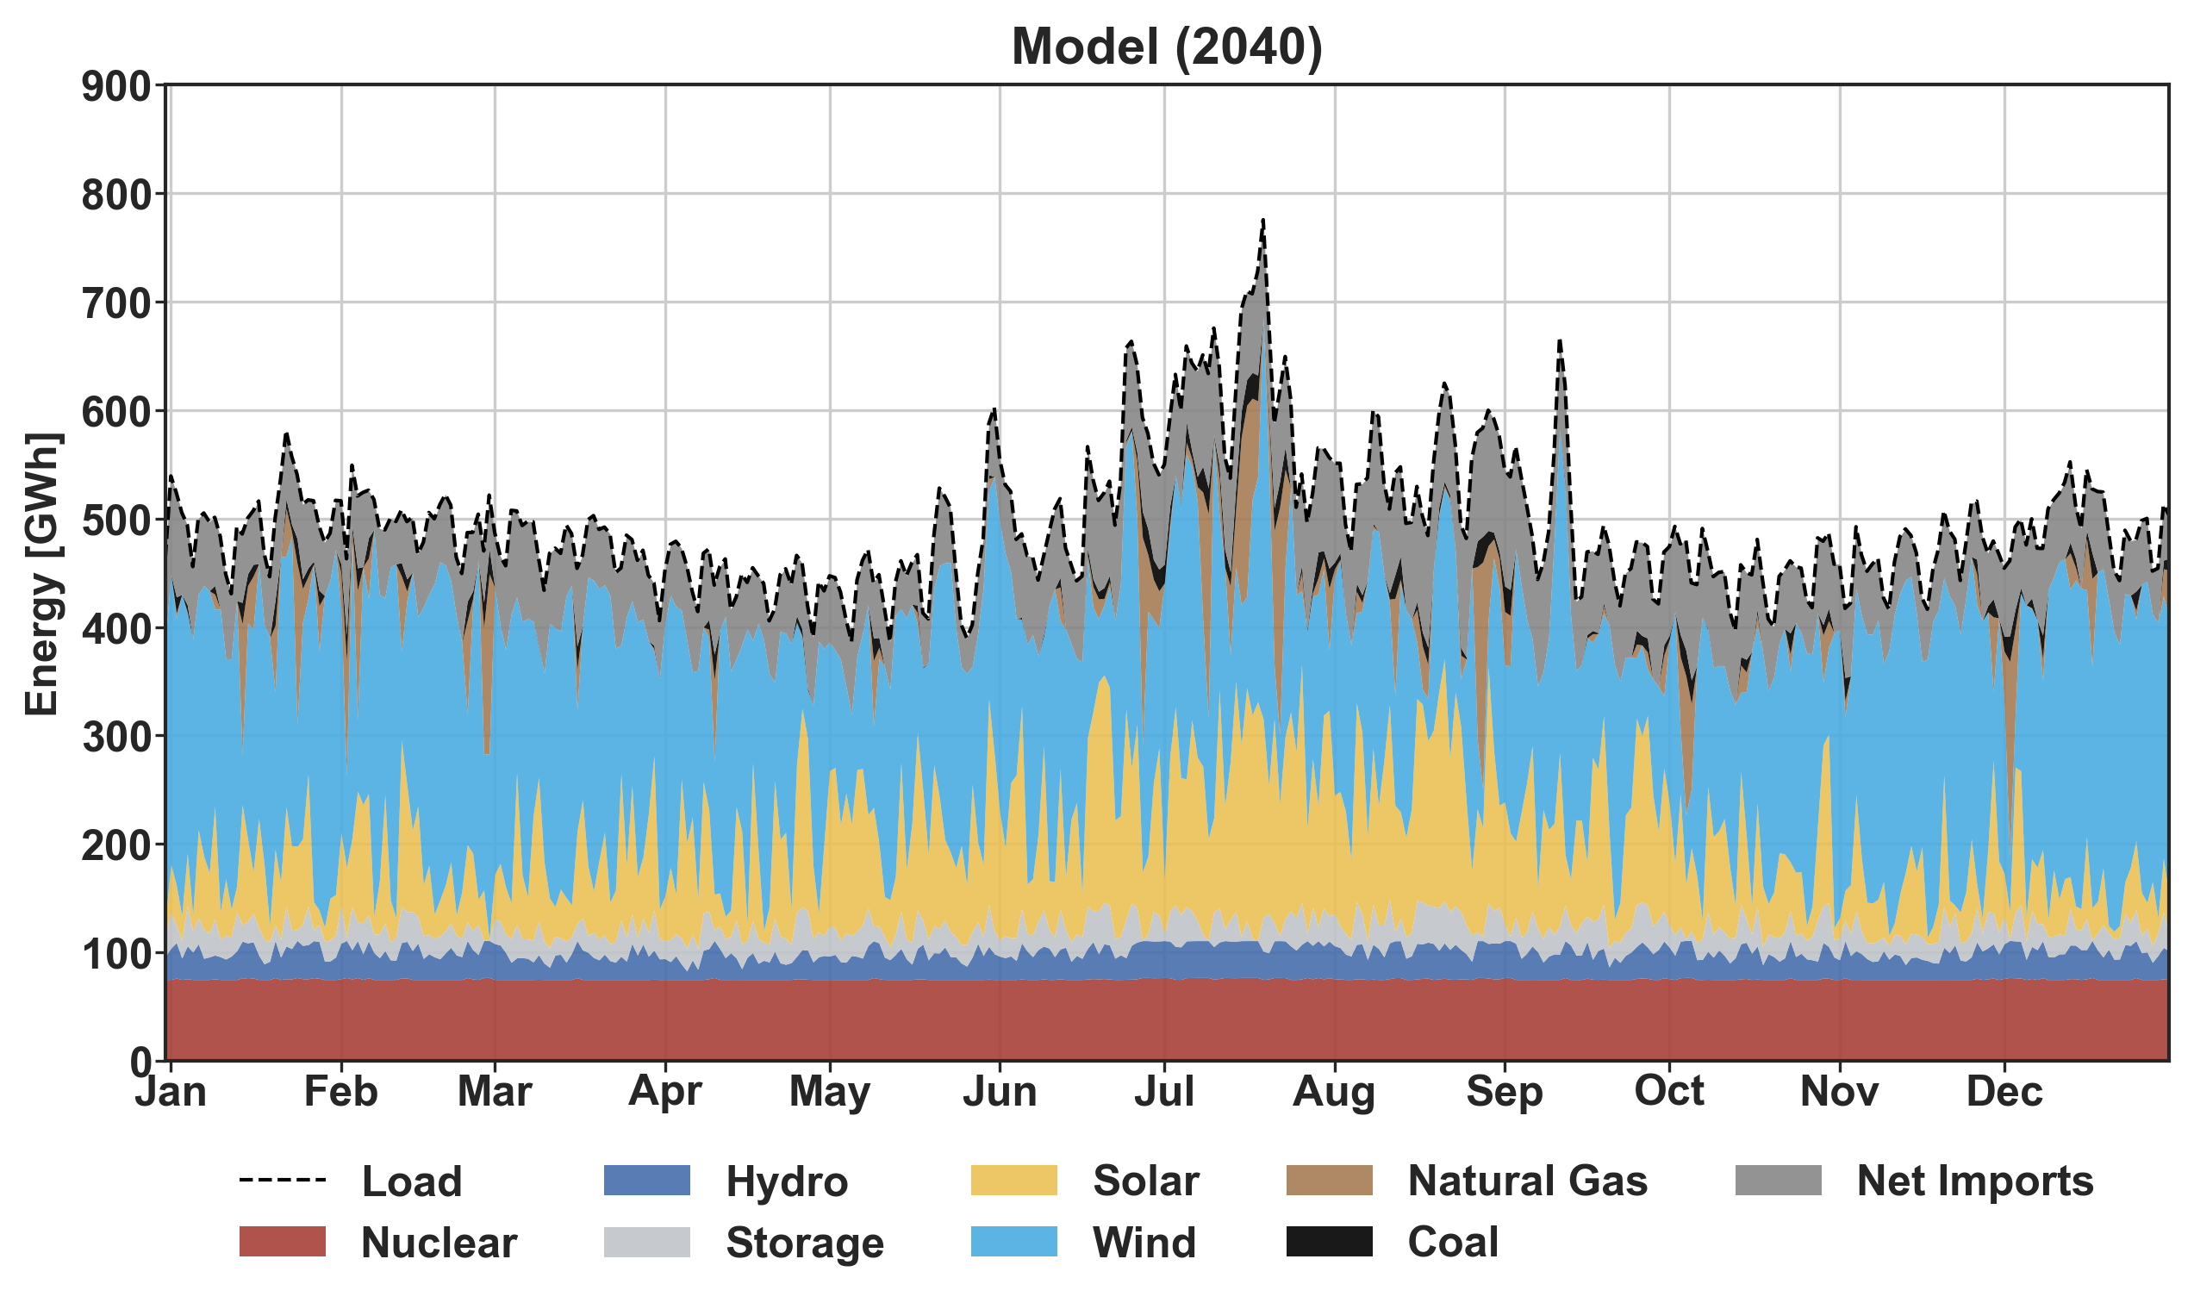
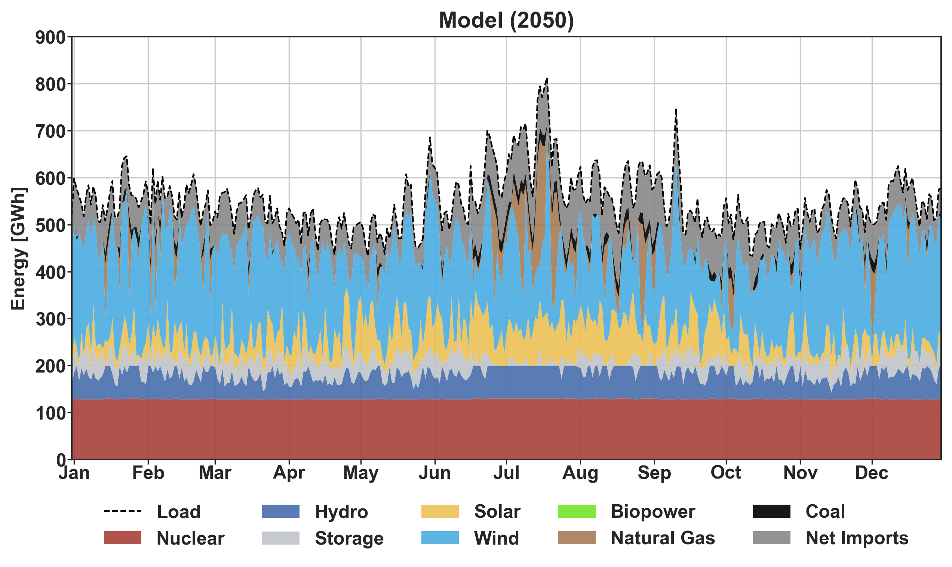
Model (2040)
Model (2050)

Slide 31
Emissions
Notes:
Add power output?

Slide 32
Energy Mix
Notes:
Add power output?

Slide 33
Curtailment
Notes:
Add power output?

Slide 34
Resource and Net Load
Notes:
Add power output?

Slide 35
Transmission
Notes:
Add power output?

Slide 36
Battery Storage
Notes:
Add power output?

Slide 37
Production Cost
Notes:
Add power output?

Slide 38
Climate Leadership and Community Protection Act (CLCPA)
The act specifies “No later than [June 13, 2021], the commission shall establish a program to require that:
(A) A minimum of [70%] of the statewide electric generation secured by jurisdictional load serving entities to meet the electrical energy requirements of all end-use customers in New York State in [2030] shall be generated by renewable energy systems [70x2030];
(B) and that by [2040] the statewide electrical demand system will be zero emissions [100x2040].”
Source: CLCPA p.17

Slide 39




Data Pipeline
Additional Modeling
Import
Generators
Costs
Power System Modeling
Weather
Python
Transformation and Analysis
Load and I&E
Activity
Notes:
Pipeline
Attributions
weather by Sumit Saengthong from the Noun Project
Network by Pause08 from the Noun Project
CSV by JunGSa from the Noun Project
Flame by DinosoftLab from the Noun Project

Slide 40
Additional Modeling
Import
Generators
Costs
Power System Modeling
Weather
Load and I&E
Activity
Notes:
Pipeline
Attributions
weather by Sumit Saengthong from the Noun Project
Network by Pause08 from the Noun Project
CSV by JunGSa from the Noun Project
Flame by DinosoftLab from the Noun Project

Slide 41
APPENDIX B

Slide 42
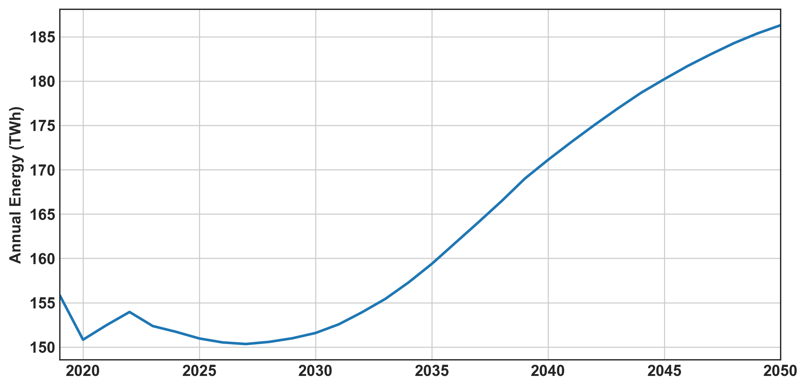
NYISO Goldbook Energy Projection

Slide 43
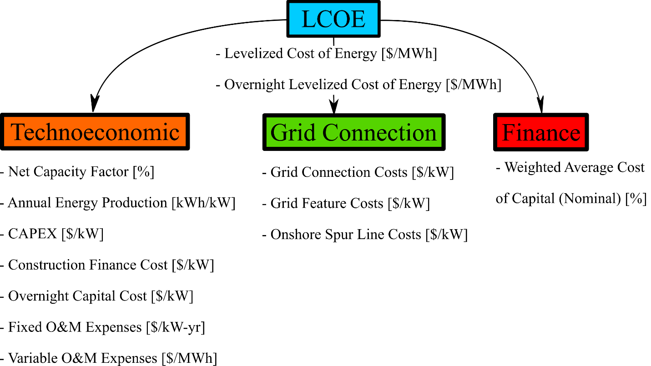
LCOE Calculation

Slide 44
LCOE Comparison
Conventional

Slide 45
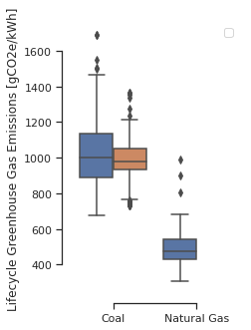
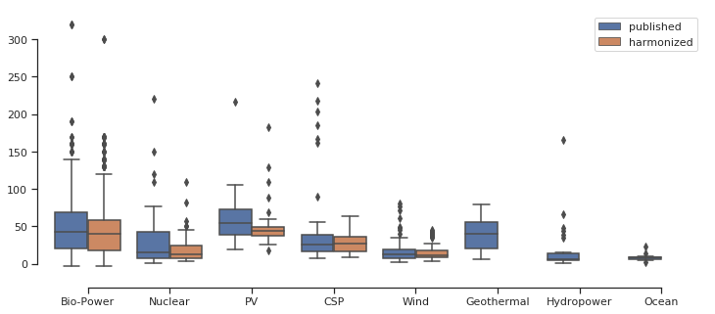
LCA Comparison
NREL LCA Harmonization

Slide 46
APPENDIX C

Slide 47
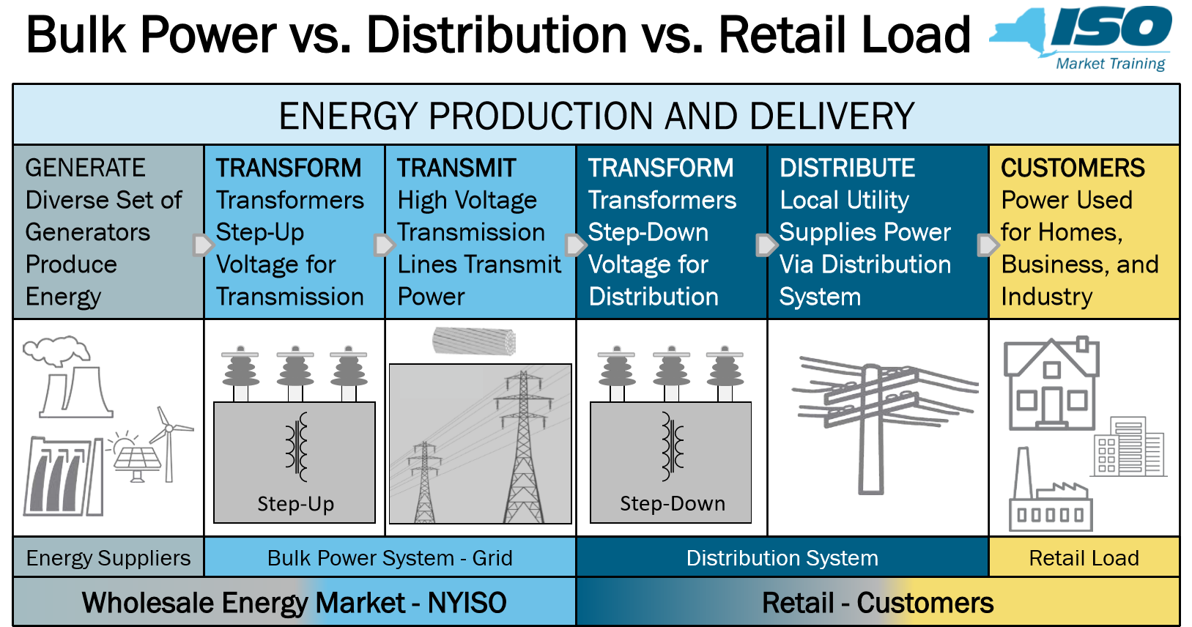

Slide 48
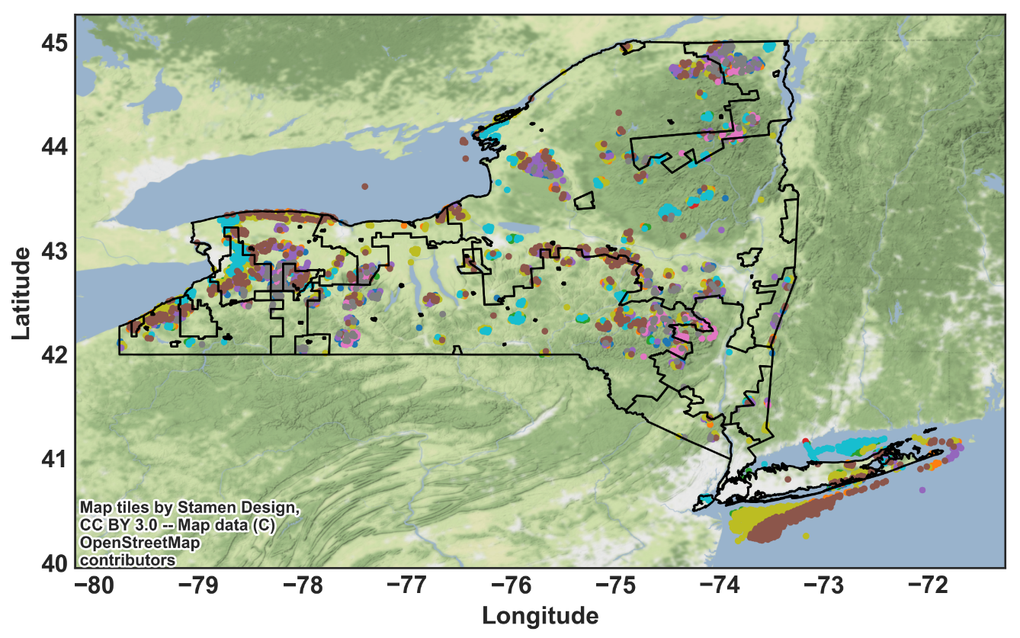
* Mid Cost Scenario and Avg CF
Generator Technologies
Fuel-based
Wind
Solar
Hydro
Coal
New
IGCC
CCS 30%
CCS 90%
Gas
CT
CC
CC CCS
Nuclear
Biopower
Dedicated
Cofire Old
Cofire New
- Onshore
- Offshore
- Utility PV
- Conventional Hydroelectric
- Pumped Storage

